Slide 1
Purpose of the Toolbox Talk
Please hide this slide before beginning your presentation.
This resource is a full Building Equality LGBT+ Inclusion Toolbox Talk.
This resource is not intended to be used in its entirety at any one time.
This resource can be used as a an anti-bullying toolbox talk, it also picks up on use of language; LGBT+ history/information; LGBT+ terminology (incl. pronouns); as well as allies and further support.
For example: you may use section 2 as the basis of your talk but also include a personal element with section 3.
Or you may do a talk for LGBT+ history month and include section 1 and section 4.
Which slides are used is purely down to the time limit available and the intended audience.
There are also many interactive elements to the toolbox talk, as well as hand-outs for participants, which are detailed in the slide notes and the further guidance document.

Slide 2
Notes:
Building Equality is an alliance of construction consultants, engineers, developers, contractors, and institutions who are passionate about working together and harnessing our collective power to drive LGBT+ inclusion in the construction industry. We have presence across the UK, with over 50 organisations from the industry regularly participating in joint initiatives to support LGBT+ inclusion.
Our vision is to have an industry that is wholly welcoming, inclusive and supportive of LGBT+ individuals.
Jacobs have been a member since 2018, taking part in pride events across the country including Manchester, Salford and Sparkle Weekend: Trans Pride.
Myself, Kathleen Harrison and Jenny Setterington represent Jacobs in Manchester. And have taken leading roles in developing Building Equality’s award-winning resources such as this toolbox talk and poster campaign, which you will see a little later on.

Slide 3

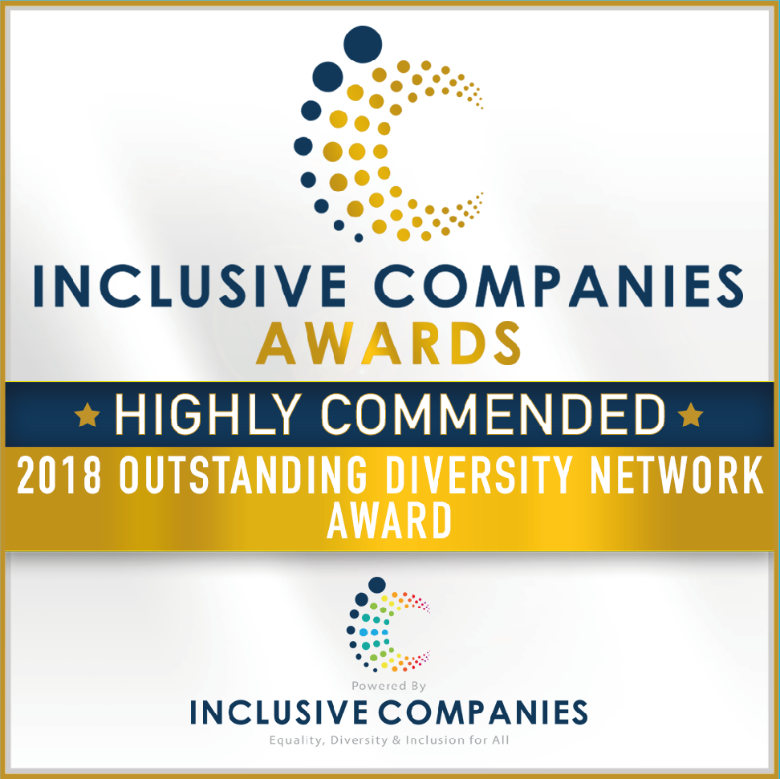

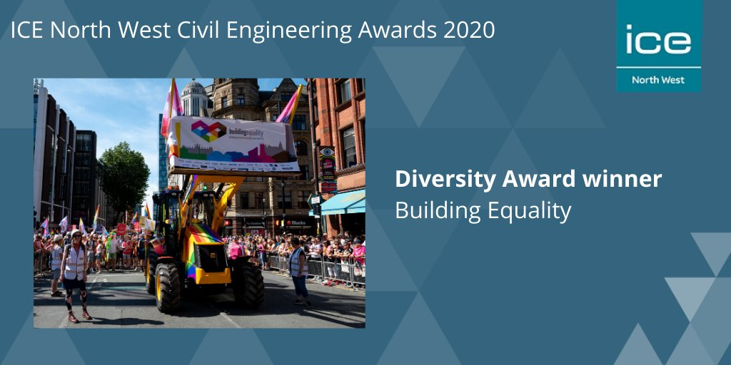
Contents
LGBT+ history, information & terminology
Equality, diversity & inclusion in construction
Questions
Information and resources
Supporting LGBT+ inclusion
Why equality, diversity and inclusion matter to me?
1
2
3
4
5
6

Slide 4
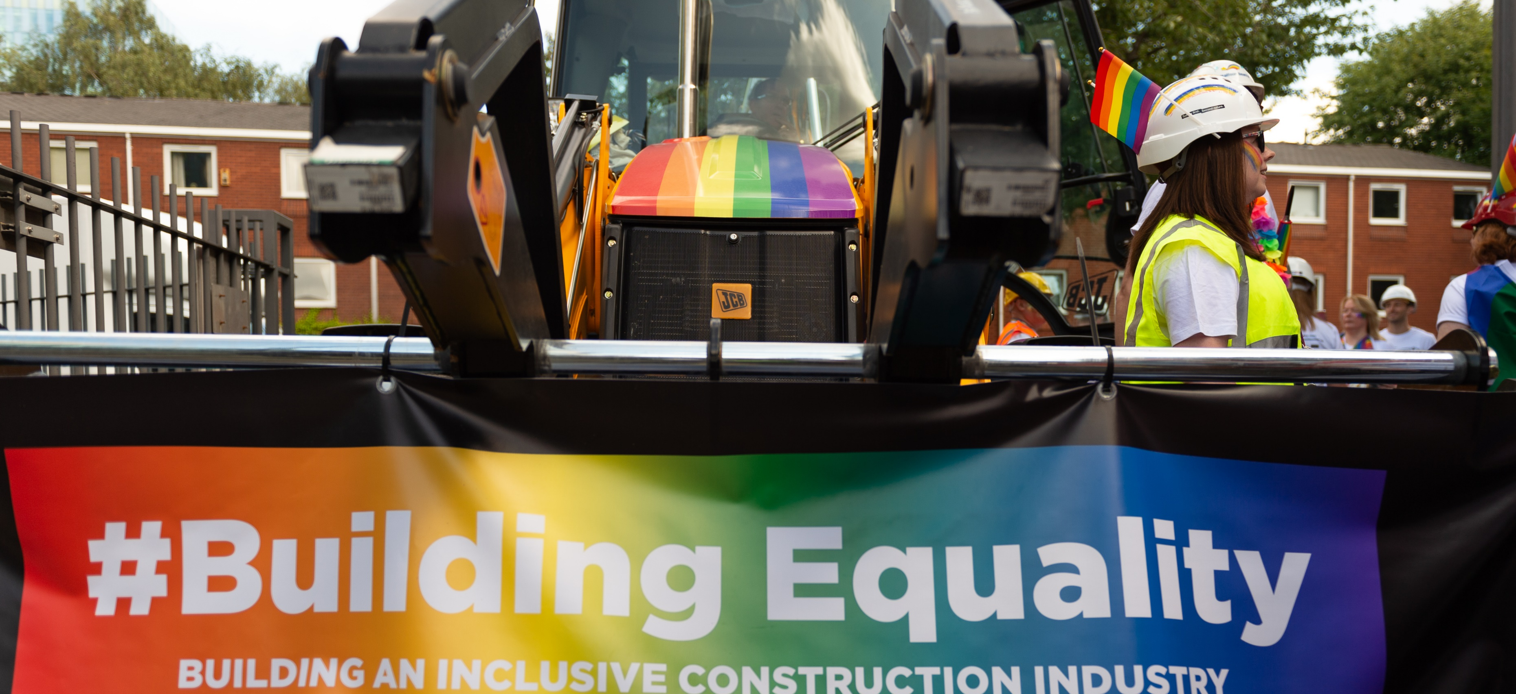
LGBT+ history, information & terminology

Slide 5
LGBT+ terminology
LGBT:
Stands for lesbian, gay, bi, and transgender. Depending on preference this will sometime include Q for queer and/or I for intersex.
The PLUS (+):
This ensures that we will always be inclusive of all identities, to make all feel welcomed and is shorthand for acronyms such as LGBTQQIAAP2S.
Cisgender:
A person whose gender identity and expression matches the gender typically associated with their biological sex. For example: a female who identifies as a woman.
LGBT-phobia:
Thoughts, feelings, or actions based on dislike, judgment, or hatred of LGBT individuals. LGBT-phobia can include prejudice, discrimination, harassment, and acts of violence.
A full glossary of terms can be found at: https://www.stonewall.org.uk/help-advice/glossary-terms
Notes:
LGBT:
Explain what LGBT+ is and what each of the letters stand for:
Lesbian – a woman who is attracted towards women.
Gay – a man who is attracted towards men. This is sometimes used for anyone who feels same-gender attraction.
Bi – a person attracted to more than one gender
Trans – a person whose gender is different from the sex they were assigned at birth.
Queer – originally used as a hate term, but has been reclaimed. (Some can still find offensive). It is often used as an umbrella term for minority sexual and gender identities
Intersex - A person who may have the characteristics of multiple sexes or biological features that do not fit society's assumptions about what is male and female
The PLUS (+):
We use the plus (+) rather than the acronym as it is all inclusive.
The reason behind why we don’t use the acronym and use the ‘+’ instead, is that everyone is unique and can and will identify differently and an acronym can sometimes struggle to include all those differing identities. Some identities that fall under the ‘+’ are:
Questioning – A person who is still exploring their sexuality or gender identity
Ace - An umbrella term used to describe differing levels of romantic and/or sexual attraction, including no attraction
Allies – Often used in regards to straight people who support the LGBT+ community but LGBT+ people can be allies too by supporting groups they are not a part of
Pan - A person who is not limited by sex or gender in their sexual and/or romantic attraction
Two-Spirit - The traditional gender variation in First People communities who often served as the community’s visionaries and healers.
Non-binary - An umbrella term for people whose gender identity doesn’t fit with ‘man’ or ‘woman’. These identities are varied and include those who identify with some aspects of binary identities, while others reject them entirely.
Genderqueer – Is often used synonymously with non-binary, and it also is an identity used by people whose gender identity does not fit the binary.
Gender fluid - someone whose gender identity may change over time.
Agender - someone who identify as genderless or gender neutral.
So, in a perfect world we would use another word, rather than an a ‘+’ or an acronym, in which we could all stand behind. As using the right labels can be tough and can also limit or misdirect people from the truth. There are also more ways in which people can identify, than what has been discussed here. Our identities are ever evolving and changing and we should always keep an open mind.

Slide 6
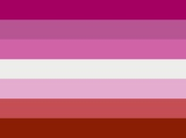







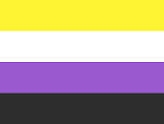




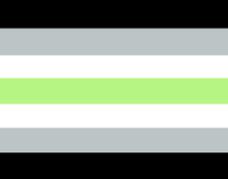
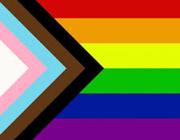
LGBT+ flags
Lesbian
Gay
Bi
Trans
Intersex
Genderqueer
Allies
Asexual
Pan
Progress
Gender Fluid
Polysexual
Aromantic
Non-binary
Agender
1. Lesbian
3. Bi
9. Pan
8. Asexual
12. Polysexual
4.Transgender
2. Gay
7. Allies
14. Non-binary
13. Aromantic
6. Genderqueer
5. Intersex
11. Gender Fluid
15. Agender
15. Progress
Notes:
Interactive: Which flag is attributed to the identities previously discussed?
Gay – ‘you may be used to seeing the flag without the black and brown, however, this has been incorporated to include a marginalised section of the gay community – Black Asian Minority Ethnic (BAME) – to show our support…’
If you want to do a bit of extra research there is a reason why all the designs and the colours have been chosen for each particular identity.
Unfortunately, we don’t have time to go through them, all today.

Slide 7
Orientation, gender identity and gender expression
Orientation
Orientation refers to a person’s emotional and/or sexual attraction to others.
Sexuality is complex and attraction can manifest very differently for different people.
Gender Identity
Gender identity is an internal sense or awareness. For most people, it can be described as a kind of man-ness or woman-ness. But gender is not limited to two, it’s not binary. There are more genders than man and woman
Gender Expression
Gender expression is how a person publicly presents their gender. This can include behaviour and outward appearance such as how someone dresses, wears their hair, if they use make-up, their body language and their voice. A person’s chosen name and pronoun are also common ways of expressing gender.

Slide 8
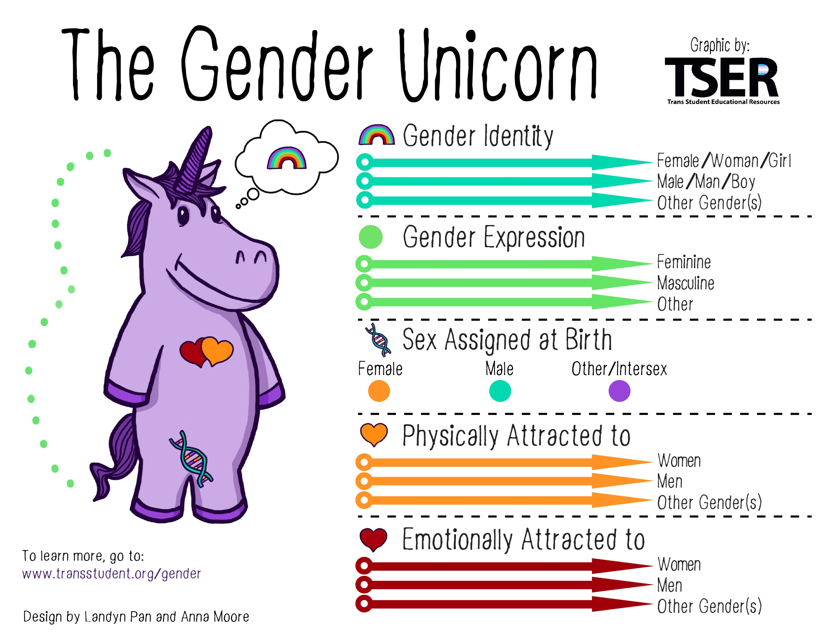
Notes:
This slide is a print out, to help audience digest what is quite difficult, and likely new for them, information.
Gender identity – what you know you are.
One’s internal sense of being male, female, neither of these, both, or another gender(s). Everyone has a gender identity, including you. For most people, it can be described as a kind of man-ness or woman-ness. But gender is not limited to two, it’s not binary. There are more genders than man and womanIt is important to note, for transgender people, their sex assigned at birth and their own internal sense of gender identity are not the same.
Gender expression / presentation – how you present yourself to others.
Gender expression is how a person publicly presents their gender. The physical manifestation of one’s gender identity; for example, clothing, hairstyle, voice, body shape, etc. A person’s chosen name and pronoun are also common ways of expressing gender.
Expression can be on a spectrum and any combination of masculine, feminine and androgynous or non-binary.
Sex assigned at birth
The assignment and classification of people as male, female, intersex, or another sex based on a combination of anatomy, hormones and chromosomes.
Physical attraction / emotional attraction
The emotional, romantic, and/or sexual attraction to individuals of any gender. Attraction is complex and can manifest very differently for different people. It is important to note that sexual and emotional attraction can be from a variety of factors, including but not limited to, gender identity, gender expression/presentation, and sex assigned at birth.
Finally - All of these things are separate from each other.
You don’t have to be very feminine to be a gay man and being transgender is different from being gay or bi or intersex.
For example, a straight man might dress in drag – which is a very feminine gender expression, but doesn’t make him gay or trans.

Slide 9
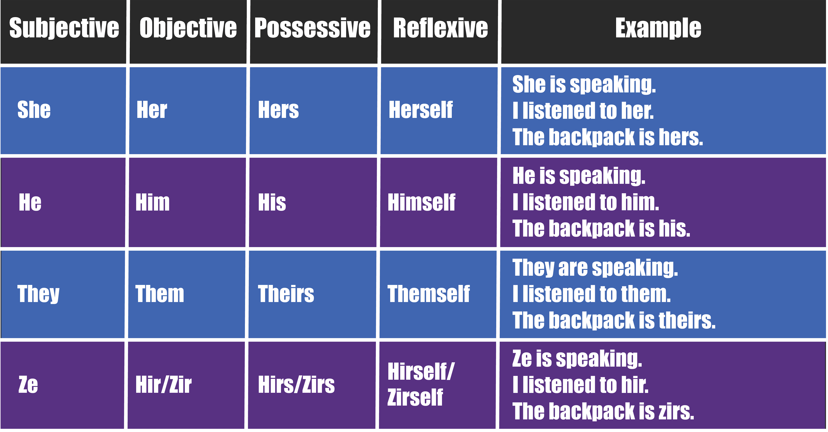

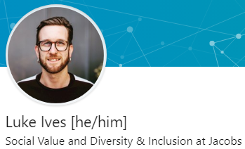


Usualising Pronouns
A gender pronoun is the pronoun that a person uses for themself.
Make stating your pronouns a part of your natural introduction and invite others to do the same, just politely ask what pronouns to use and trust their answer: https://www.mypronouns.org/sharing
See glossary: https://www.stonewall.org.uk/help-advice/glossary-terms
Notes:
A gender pronoun is the pronoun that a person uses for themself. As detailed in the table.
And an easy way for you to show your pronouns is in your email signature or on social media handles.
But why share pronouns?
Being misgendered is a real problem for many, including non-binary, trans and intersex people
For most of us, our singular and visible gender identity is never questioned and we are not mis-gendered
But not everybody has that privilege; and those that are referred to with the wrong pronouns can feel disrespected, invalidated, and alienated.
By using gender pronouns to introduce yourself can:
- help everyone feel included and respected
- show people that you are an ally
- acknowledge that pronouns shouldn’t be assumed
encourage people to think about their own gender
It is a great step in being truly inclusive. It brings awareness to something that people may not have known about previously. Gets the conversation started.
So, how can you ask someone their pronouns? Simply as part of an introduction, you can say “Tell us your name, your role, and if you’re comfortable, your pronouns”
Or if you are unsure, just ask someone “Can you remind me of which pronouns you use for yourself?” They won’t be offended.
If in a situation you notice you use the wrong pronouns correct yourself. Apologise and restate the correct pronoun, as in, “Sorry, I meant they.” If you realise your mistake after the fact, apologise in private and move on. In either case, don’t dwell on the mistake.
At Jacobs we have introduced pronouns into the conversation by adding them to email signatures. Think about adding yours if you ahven’t.
And if you have added them think linking your pronouns to a website with further information.
As you can see I have also included my pronouns on my social media. This is another simple way to be an ally and show I care and respect my peers outside of a work setting.
Please note that these are not the only pronouns. There are an infinite number of pronouns as new ones emerge in our language.
Use those links when these slides are sent around for a bit of background reading.

Slide 10
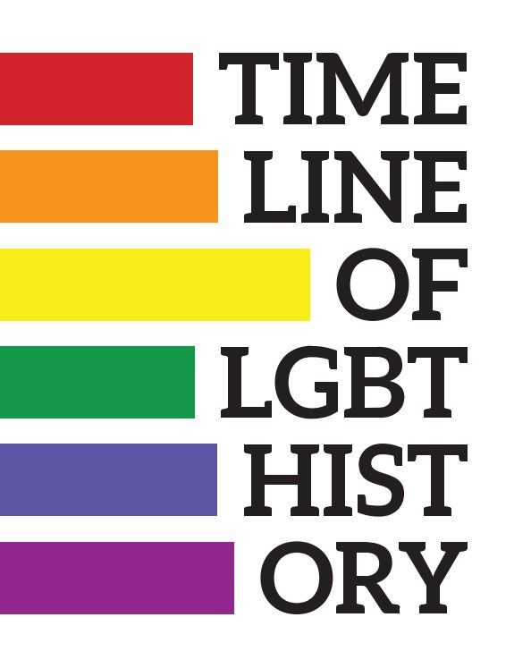

Look how times have changed…
1960s
1965
Poll finds 93% think homosexuality is an illness requiring treatment
1967
Homosexual acts decriminalised
1969
Stonewall Riots
1969
Campaign for Homosexual Equality (CHE) formed
1970s
1970
Gay Liberation Front established
1972
First British Gay Pride Rally held in London
1974
First TV/TS conference held in Leeds
1975
The Naked Civil Servant aired on ITV
1980s
1981
ECHR struck down NI’s criminalisation of Homosexual Acts
1982
AIDS crisis - initially called gay-related immune deficiency
1982
Homosexual acts decriminalised in NI
1987
Section 28 introduced
1990s
1990
First gay pride held in Manchester
1994
Sodomy laws repealed on IoM
1998
Bolton 7 convicted
1999
Admiral Duncan Bombing
2000s
2000
Labour scrap Armed Forces Policy (2016)
2001
Age of consent for Gay men equalled at 16
2002
Equal rights to adopt
2003
Section 28 repealed
2004
Civil Partnerships
2007
Equality Act
2010s
2013
Alan Turing posthumous pardon
2014
Same Sex Marriage becomes legal in England and Wales
(excluding C of E)
2016
40 LGBT MPs – most in the world
2018
First member of the royal family to marry same sex
Notes:
To be edited by the presenter can swop and change, facts not included at present:
1967 – Homosexual acts in private between two men over the age of 21 decriminalised
1974 – Maureen Colquhoun came out as the first lesbian Labour MP
2008 - Treatment of Lesbian parents/children equal

Slide 11



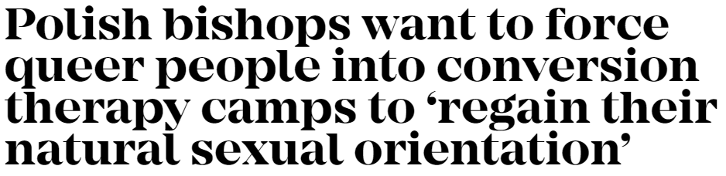

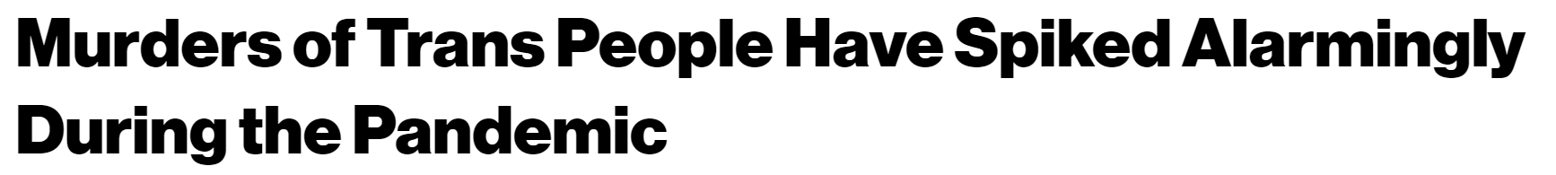
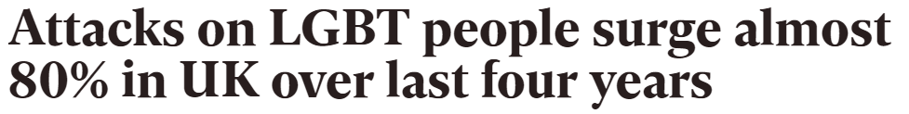
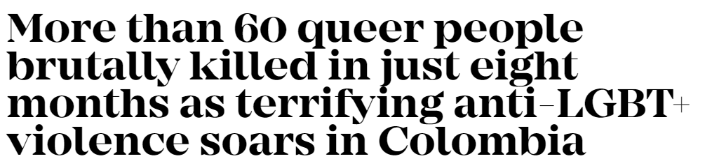
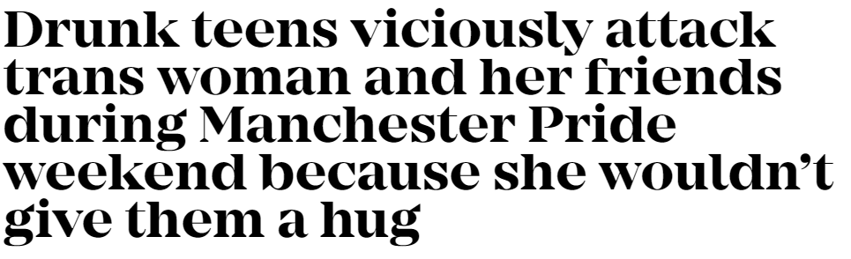

But we still have work to do…
Notes:
Despite positive changes in the law and in general perception, there are still significant issues across the globe and in some places LGBT+ rights are taking a step backwards.
This isn’t just a Middle East or South American problem, this is a European and UK issue.
Attacks on LGBT+ are happening right here on our doorstep.

Slide 12
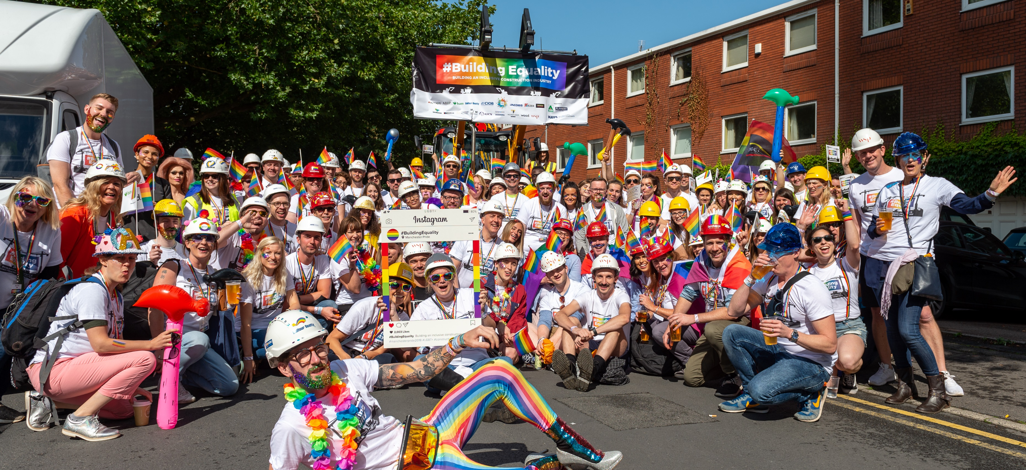
Equality, diversity & inclusion in construction

Slide 13
Minorities in construction
In the whole UK workforce:
2.5% LGBT+
- ons.gov.uk
19% Black, Asian, Minority Ethnic (BAME)
- ethnicity-facts-figures.service.gov.uk
46% Female
- researchbriefings.files.parliament.uk/documents/SN06838/SN06838.pdf
In the construction workforce:
1% LGBT+ / 1 in 40
- constructionnews.co.uk
7% BAME / 1 in 14
- ethnicity-facts-figures.service.gov.uk
11% Female / 1 in 9
- wisecampaign.org.uk
This means there could be around 50,000 LGBT+ people working in construction.
It is three times the number who have worked on Crossrail since the project began in 2009, and more than twice as many as will be needed to deliver HS2.
But large portions of this workforce feel uncomfortable, hindered or ostracised because of their sexuality or gender while working in this industry - though attitudes appear to be slowly improving.
Notes:
Ask the group to guess the statistics!
The stats are probably lower on construction sites as this takes into consideration offices.
There are around 50,000 LGBT+ working in construction. 3x the number that has worked on Crossrail / more than twice as many needed for HS2.
But there are still very visible barriers that this group of 50,000 individuals have to overcome.
Large portions of our workforce still don’t feel they can be themselves and feel the industry has had a negative impact on their lives.
LGBT-phobia is still rife, working environemnts can still be hostile
But attitudes are changing and our industries approach is changing.
And we all have work to do to make sure that our industry is welcoming and accepting to everyone, so all can be their best. .
Data from;
LGBT
The proportion of the UK population identifying as LGB in 2017 was 2%
https://www.ons.gov.uk/peoplepopulationandcommunity/culturalidentity/sexuality/bulletins/sexualidentityuk/2017
AND
LGBT+ 2.5%
https://www.constructionnews.co.uk/data/lgbt-survey-constructions-slow-progress-laid-bare/10027190.article
BAME 19%
https://www.ethnicity-facts-figures.service.gov.uk/work-pay-and-benefits/employment/employment/latest
Woman in Workforce 15.3m / 33.4m employed = 46%
http://researchbriefings.files.parliament.uk/documents/SN06838/SN06838.pdf
*LGBT in Construction 3% NOTE – We struggled to pinpoint a statistic for this, Construction News have used the ONS population data.
https://www.constructionnews.co.uk/data/lgbt-survey-constructions-slow-progress-laid-bare/10027190.article
BAME in Construction 7%
https://www.ethnicity-facts-figures.service.gov.uk/work-pay-and-benefits/employment/employment-by-sector/latest
Woman in Construction 11%
https://www.wisecampaign.org.uk/statistics/2018-workforce-statistics/
Other sources include;
Construction News, Stonewall, YouGov, EuroClinix, UK Government, and Catalyst.

Slide 14
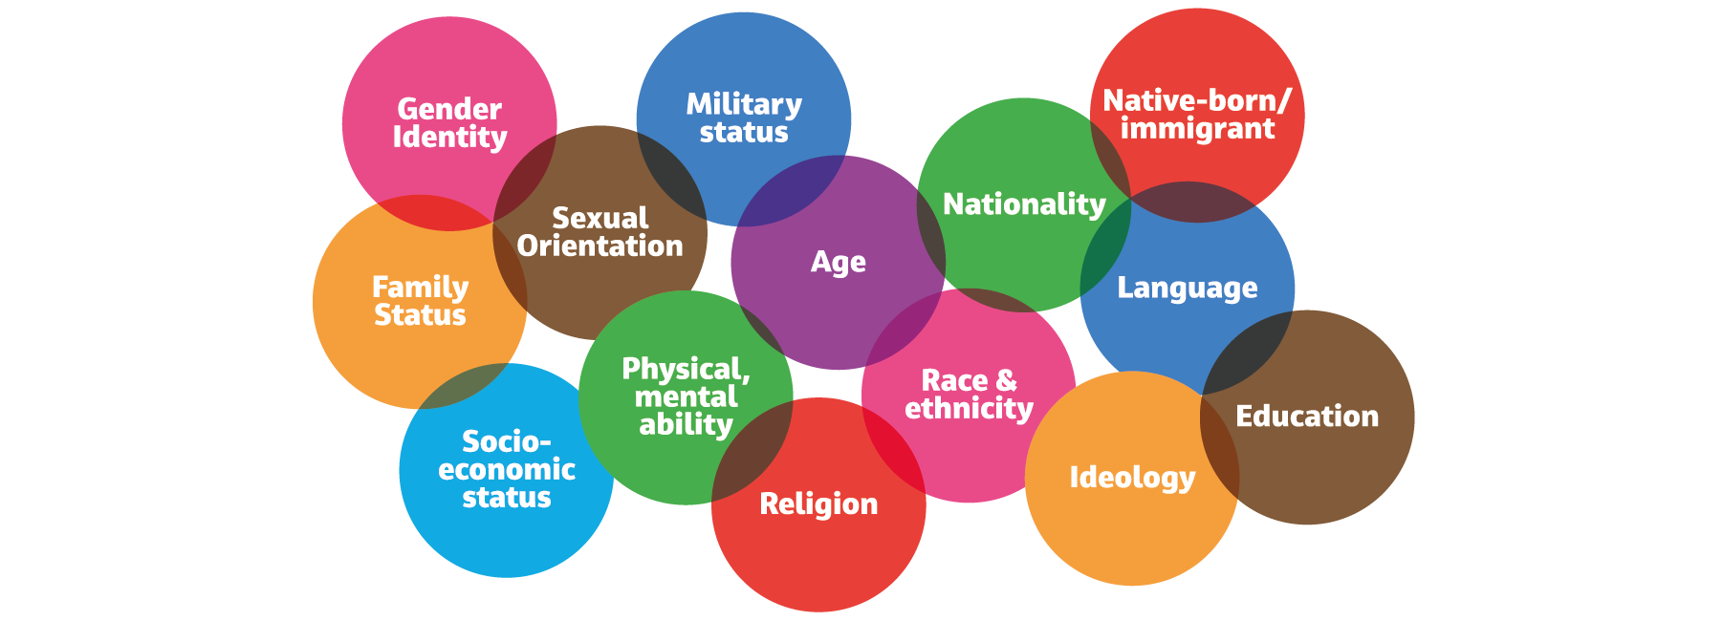
Minorities in construction
Notes:
When we think of minorities, we think of strict boxes and labels. So being LGBT+ or being disabled but we actually need to remove these strict boxes and labels and see the whole minority story – the intersectionality.
But what is intersectionality? An intersectional person is someone who is part of a number of different marginalised groups.
For example, some intersections could be being gay and black or being a women and disabled.
Intersectionality looks at all elements of identity – so a white, straight man is still intersectional. However, the term intersectionality was created, by Kimberle Crenshaw, to specifically illustrate marginalised communities.
She used it to explain the problems that immigrant women of colour were facing in the 1980s. She felt that neither the feminist or anti-racist movements were fully helping them solve the problems.
And LGBT+ activism can also sometimes struggle to address the problems of intersectional LGBT+ people.
TV and film for example, modern family, Will and Grace, Brokeback Mountain, Call me by your Name feature some amazing LGBT+ characters. But they are only white, cis, middle/upper class, gay men.
In contrast Moonlight is much more intersectional. The lead character, Chiron, is not only gay but also black and poor. These aspects of Chiron inform each other. But even in Moonlight there is an absence of queer women.
So, It’s important to remember that people have lots of different elements to their identity and this may mean they suffer multiple levels of discrimination in their life.
We need to be aware of intersectional identities and make sure we are representative and inclusive and all varying identities.
Not just white, cis, gay men.
Having an intersectional identity can also often generates a feeling that someone does not completely belong in one group or another, and can lead to isolation, depression and other mental health issues. Which is why we need to start linking up minority groups and addressing the bigger picture.

Slide 15
The barriers to LGBT+ individuals in the Built Environment
Construction News LGBT+ survey: progress laid bare
How many believed their sexuality and/or gender identity created
career progression barriers?
How many have experienced offensive or inappropriate comments about
their sexuality or gender identity in work?
How many do not feel comfortable being open about their sexuality
and/or gender identity on site?
How many have overheard “gay” being used as an insult in the workplace?
How many feel that working in the construction industry has had a negative
impact on their mental health?
60%
28%
54%
59%
31%
Notes:
So, what are the barriers to LGBT+ individuals in construction?
In a 2017 Construction News survey, the LGBT+ community in our industry was asked a series of questions regarding LGBT+ inclusion progress.
The survey covered respondents from Architecture, Construction and Engineering.
Now not always everyone believes there is a problem in the construction industry when it comes to LGBT+ inclusion but sadly these statistics prove there is.
60% believed being LGBT+ created barriers to progression
28% Have faced homophobic abuse at work?
54% are not comfortable being open?
59% Overhead gay as an insult
31% Believe the industry has had a negative impact on their mental health

Slide 16
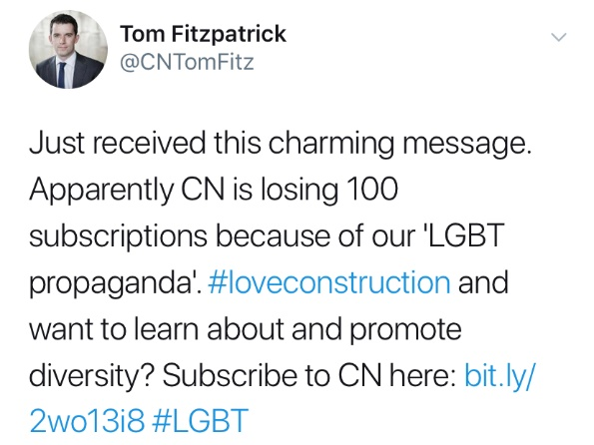
The barriers to LGBT+ individuals in construction
“Hi Tom,
Is CN the new mouthpiece for the LGBT community.
Pathetic. Who cares about how many LGBT people work within the construction sector.
We have advised all our clients to cancel their subscription with CN and aware latest figures are that just over 100 have agreed to cancel
We have cancelled ours and changed to a different supplier as I am sick and tired of having this perversion rammed down our throats.
The majority of people/ clients we know, don’t give a toss about the LGBT community.”
So, just how hard is it not being open about gender or sexuality?
With a friend or colleague, talk about what you did on your weekend…
… but you can’t use any names, places, or gendered pronouns.
Notes:
Shortly after this survey, the then editor of Construction News received the following email.
I shall elave you to read the one on the screen whilst I read another out.
Another email received was from a board member of a small property company, who he wouldn’t know if being LGBT+ has had a negative impact on his mental health as he is “normal” (straight).
He added: “Best advice is to stop shoving your perverted lifestyle down [the throats of] 99 per cent of the British population who are not queers,” and described LGBT issues as “crap”.
So when you are faced with this out right LGBT-Phobia, you can understand why people are not open about their sexuality or gender identity.
But to understand why it is bad for business and why it is bad for individuals you need to see just how hard it is not being open.
When you go away from this module, try talking about your weekend with a friend or colleague but you can’t use any names, places or gendered pronouns. And see how much effort and energy it takes.

Slide 17
Hate crime, discrimination and microaggressions?
‘Hate incidents and hate crime are acts of violence or hostility directed at people because of who they are or who someone thinks they are.’ – Citizens Advice
What is the difference between a hate crime and discrimination?
Microaggressions - What are they?
‘It’s just a phase’
‘Which one is the man and which one is the woman?’
‘You don’t act LGBT+’ or ‘I would never have guessed’
‘You can’t be LGBT+ and of faith’
‘When did you decide to be LGBT+’
‘They’re a non-practicing bi person’
Notes:
So when we think of the barriers LGBT+ individuals still face, they are normally a direct consequence of hate crimes, discrimination and microaggressions.
So what is a Hate Crime?
Hate incidents and hate crimes are acts of violence or hostility directed at people because of who they are or who someone thinks they are. For example, having abuse shouted at you on the street because for holding hands with your same-sex partner.
A hate crime is any illegal act that the victim, or any other person, perceives to be motivated by hostility or prejudices towards an aspect of a person's identity.
It is a hate crime if someone shouts homophobic, biphobic or transphobic abuse at someone in the street, or physically attacks them because they think they’re LGBT+.
Hate crime
One in five LGBT people (21%) have experienced a hate crime or incident due to their sexual orientation and/or gender identity in the last 12 months
Two in five trans people (41%) have experienced a hate crime or incident because of their gender identity in the last 12 months
What is the difference between a Hate Crime and Discrimination
Discrimination is being treated unfairly due to a protected characteristic.
LGBT people experience discrimination and poor treatment because of their sexual orientation or gender identity in many areas of public life, and often change their behaviour because they fear that they will experience discrimination. This is also the case with the construction industry both on site and in offices.
One in six LGBT people (17%) who visited a café, restaurant, bar or nightclub in the last 12 months have been discriminated against based on their sexual orientation and/or gender identity
Almost three in 10 LGBT people (28%) who visited a faith service or place of worship in the past 12 months experienced discrimination
Microaggression
A "micro aggression," is a commonplace daily verbal, behavioural, or environmental humiliation, whether intentional or unintentional, that communicates a hostile, derogatory, or negative insult toward someone.
‘You can’t be LGBT+ and of faith’
‘When did you decide to be LGBT+’
‘They’re a non-practicing bi person’
Now these microaggressions may not seem all that bad. But when these are a regular, daily occurrence the affect can take its toll.
Think of them as mosquito bites. One is annoying but not that much of a bother but 50 mosquito bites is a different story.

Slide 18
Harassment at work
The Equality Act 2010 defines sexual harassment as unwanted conduct of a sexual nature, which creates an intimidating, hostile, degrading, humiliating or offensive environment for them.
TUC’s sexual harassment of LGBT+ people in the workplace report:
How many LGBT+ individuals have experienced at
least one form of sexual harassment at work
How many LGBT+ individuals have heard comments
of a sexual nature about their sexual orientation
How many LGBT+ individuals have heard comments
of a sexual nature about their gender identity
68%
43%
30%
Notes:
TUC undertook the workplace report to understand LGBT+ people’s experience of sexual harassment at work.
This is something often overlooked or brushed under the carpet and not really addressed.
But looking at these statistics, it shows some shocking workplace culture. And we really do have an issue that needs to be addressed.
https://www.tuc.org.uk/sites/default/files/LGBT_Sexual_Harassment_Report_0.pdf

Slide 19

The effects
Like other minority groups, people who are LGBT+ may experience increased prejudice and discrimination, with research showing this has a detrimental impact on the individual.
Life and work implications
Reduced concentration
Poor productivity
Work absence
Career progression
Social withdrawal
Family and/or relationship breakdown
Health implications
Mood fluctuations
Anxiety
Depression
Fatigue
Reduced immunity
Self harm
At worst – suicide
LGBT+ individuals are 50% more likely to have mental health problems and twice as likely to attempt suicide – Stonewall
31% of LGBT+ individuals feel working in construction has had a negative impact on their mental health – CN’s Survey
Notes:
Now lets think about not being open at work, hate crimes, discrimination, microaggressions and increased levels of harassment and see the implications and the effects of this on individuals.
As we’ve discussed LGBT+ individuals face increased prejudice and discrimination, and do face these on an almost daily basis.
What are the life implications?
Stats
What are the health implications?
Stats
Substance Use: Gay, lesbian, bisexual and transgender youth are more than twice as likely to experiment with drugs and alcohol. [1]
Happiness: Only 37% of LGBT youth report being happy, while 67% of non-LGBT youth say they are happy. However, over 80% of LGBT youth believe they will be happy eventually, with nearly half believing that they will need to move away from their current town to find happiness. [1]
Self-Harm: With each instance of verbal or physical harassment, the risk of self-harm among LGBT youth is 2 ½ times more likely. [2]
Suicide: Gay, lesbian, and bisexual youth are 4 times more likely to attempt suicide than their heterosexual counterparts.[3]
LGBT+ individuals are 50% more likely to have mental health problems and twice as likely to attempt suicide
31% of LGBT+ individuals feel that working in the construction industry has had a negative impact on their mental health
[1] Human Rights Campaign. (2013). Growing Up LGBT in America: HRC Youth Survey Report Key Findings. Washington, D.C.
[2] IMPACT. (2010). Mental health disorders, psychological distress, and suicidality in a diverse sample of lesbian, gay, bisexual, and transgender youths. American Journal of Public Health. 100(12), 2426-32.
[3] CDC. (2011). Sexual Identity, Sex of Sexual Contacts, and Health-Risk Behaviors Among Students in Grades 9-12: Youth Risk Behavior Surveillance. Atlanta, GA: U.S. Department of Health and Human Services.
[4] Kosciw, J. G., Greytak, E. A., Bartkiewicz, M. J., Boesen, M. J., & Palmer, N. A. (2012). The 2011 National School Climate Survey: The experiences of lesbian, gay, bisexual and transgender youth in our nation’s schools. New York: GLSEN.

Slide 20
How we can become wholly LGBT+ inclusive?
We have few minority and LGBT+ role models in our industry, and even fewer at board-level.
But this is changing and we are beginning to see real focus on Equality, Diversity and Inclusion, in order to attract and retain the diverse skills and experiences we need in our industry.
We need increased visibility, collaboration and engagement, so we can affect positive change by:
Raising awareness and addressing LGBT+ matters;
Supporting and encouraging LGBT+ and Ally role models;
Embedding the importance of LGBT+ inclusive workplaces; and
Notes:
Read role models and changing off slide first.
We are starting to see diversity as the solution and not the problem.
Through increased visibility, collaboration and engagement we can affect positive change.
Raising awareness and addressing key LGBT+ matters – Building Equality recently sent out an open letter to the industry to sign up to the trans rights are human rights pledge to raise awareness of the Gender Recognition Act Reform;
Supporting and encouraging LGBT+ and Ally role models, Make work and team environments safe where others feel comfortable being their true selves. Highlight and celebrate those that are, to encourage others to do the same
Embed the importance of LGBT+ inclusive workplaces; into company culture, making it a key value not an add on – through policy, support and networks. LGBT+ inclusive workplaces create better job satisfaction and productivity, improved company reputation, greater innovation, etc etc.
We can become wholly LGBT+ inclusive by:
Getting people involved across our organisation, especially engaging employees who don’t identify as LGBT+ – Allies are a crucial element of ensuring inclusion for all. They can help spread the message that diversity is celebrated by your organisation.
Ensure senior support - to send a positive message of acceptance throughout the organisation
Celebrate our success – no matter how big or small,
Get involved in Building Equality initiatives across the UK. There are 9 regions – Manchester, London, Leeds, Sheffield, Birmingham, Newcastle, Glasgow, Nottingham, Bristol and Cardiff. So there is plenty of opportunity to get involved with pride events, awareness events and knowledge shares, outreach days or even assisting in development of our award-winning resources. Such as the poster campaign.

Slide 21
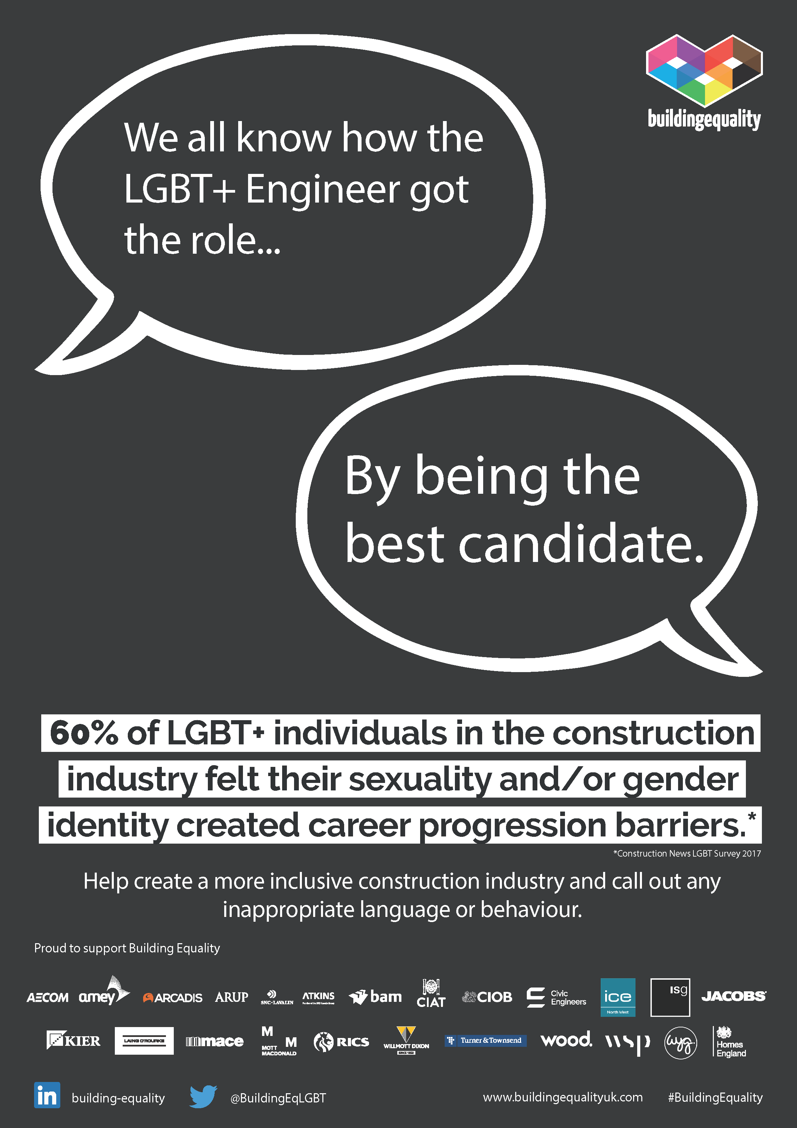
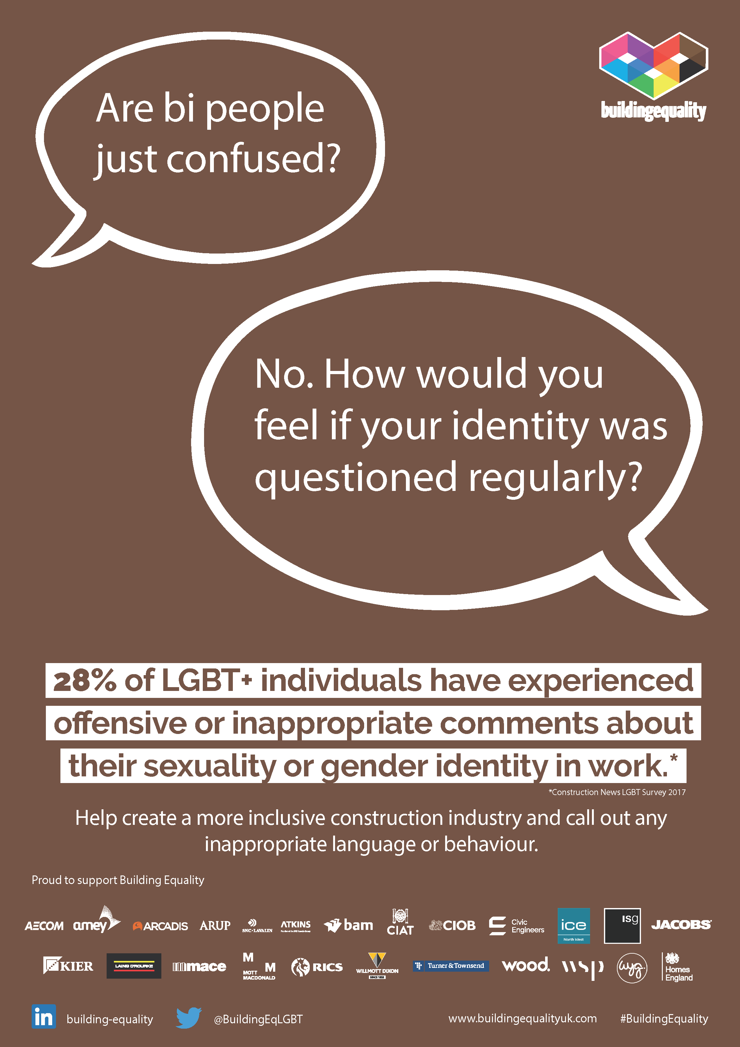
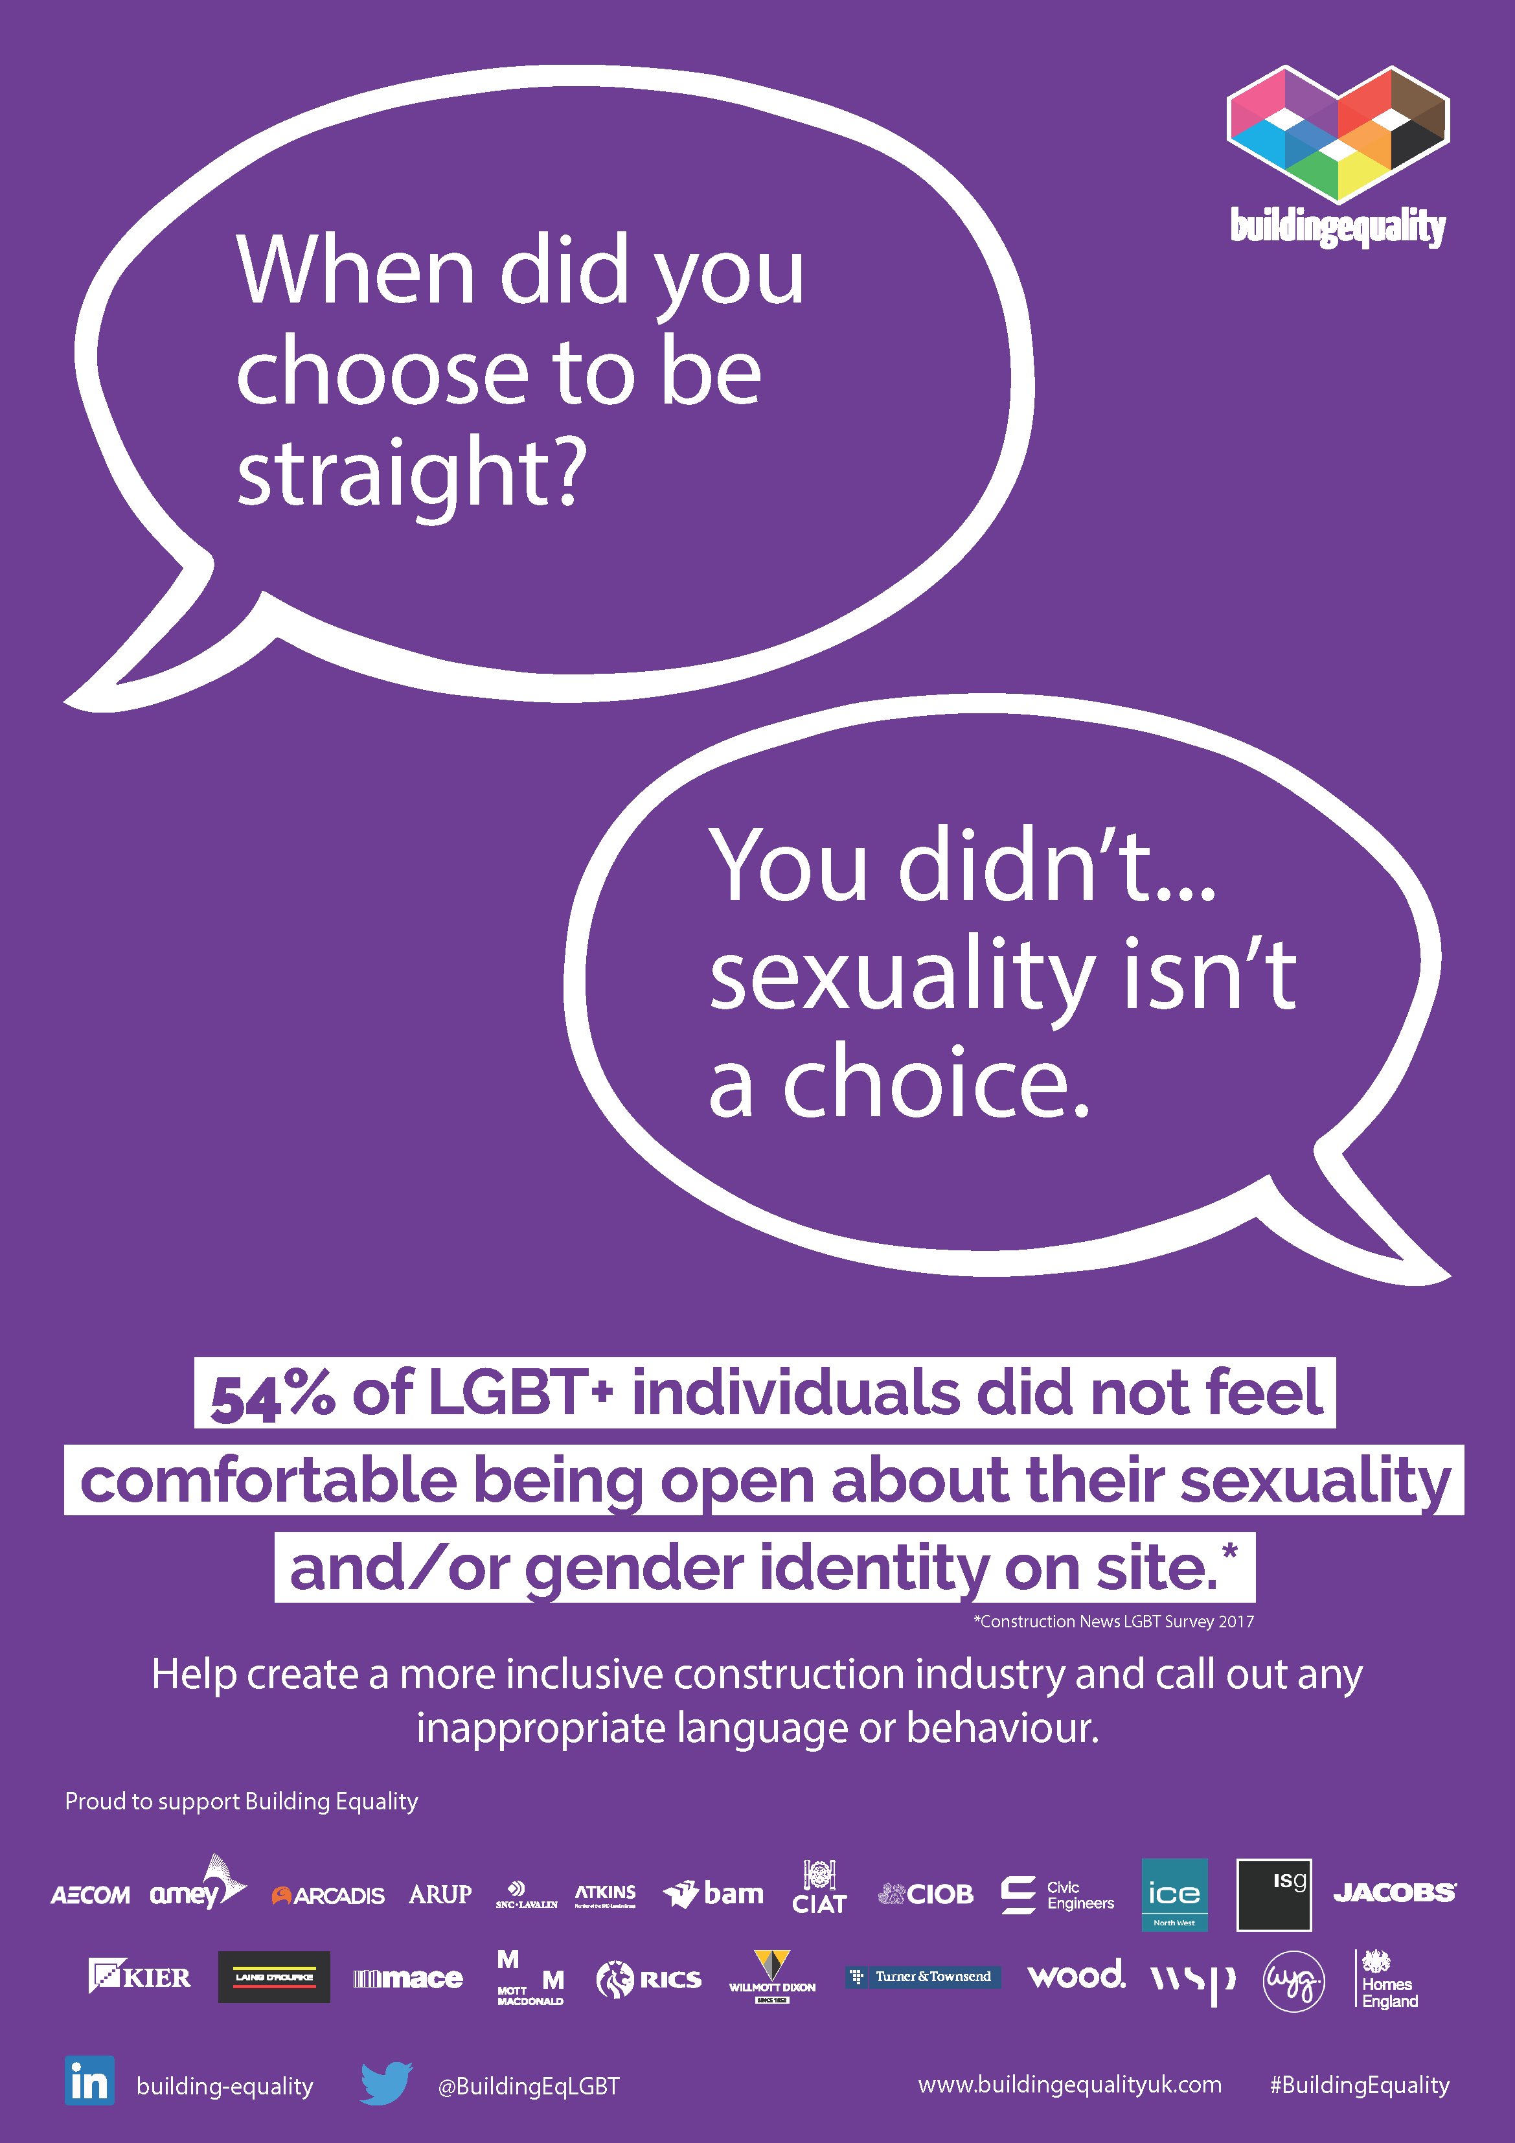
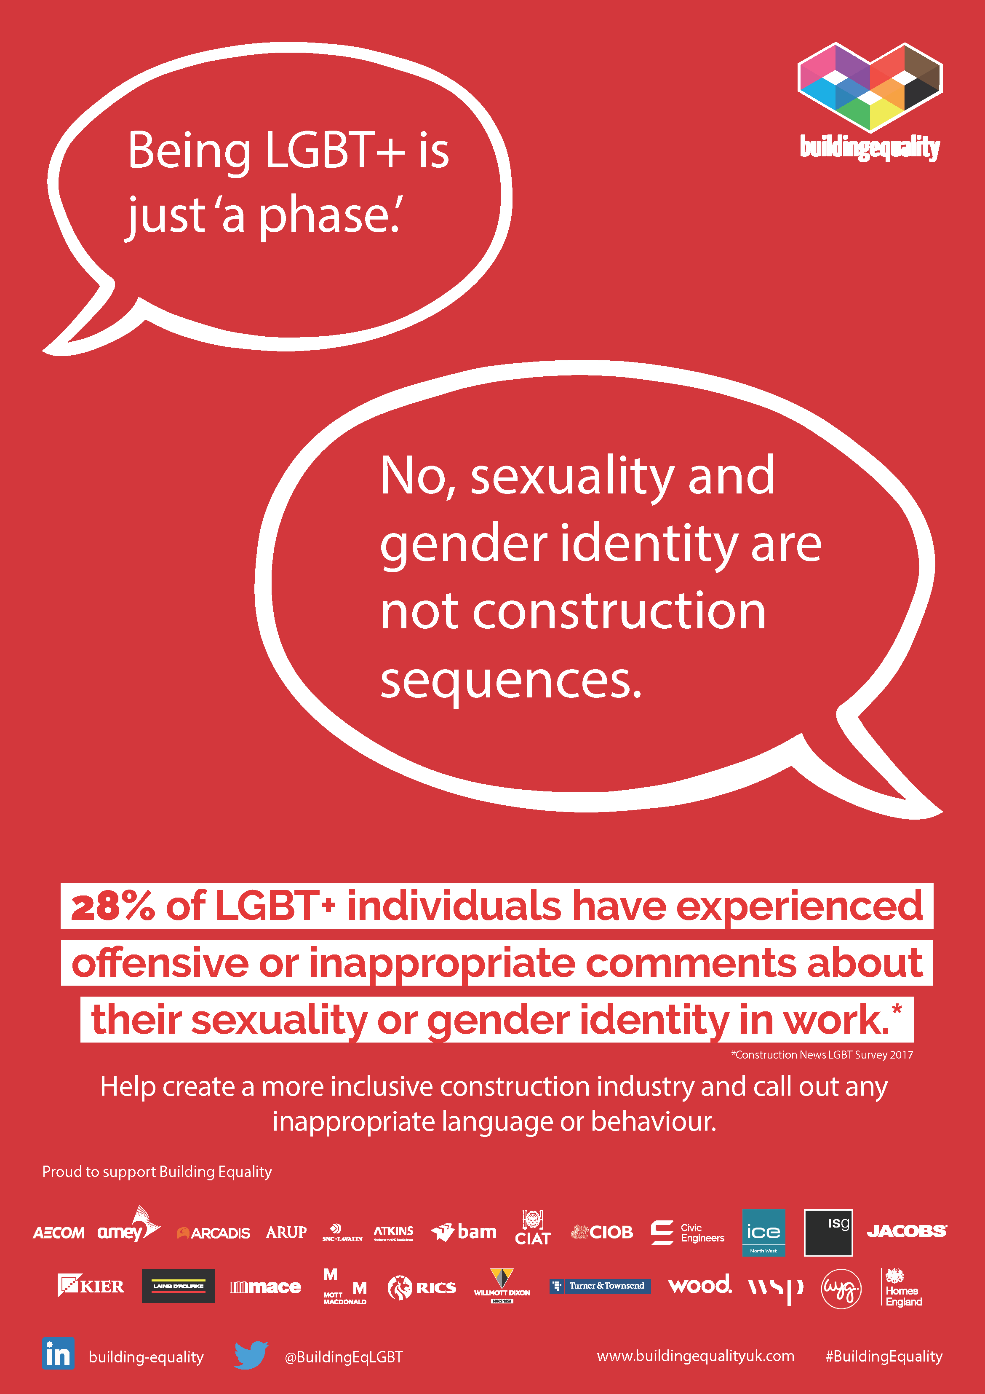
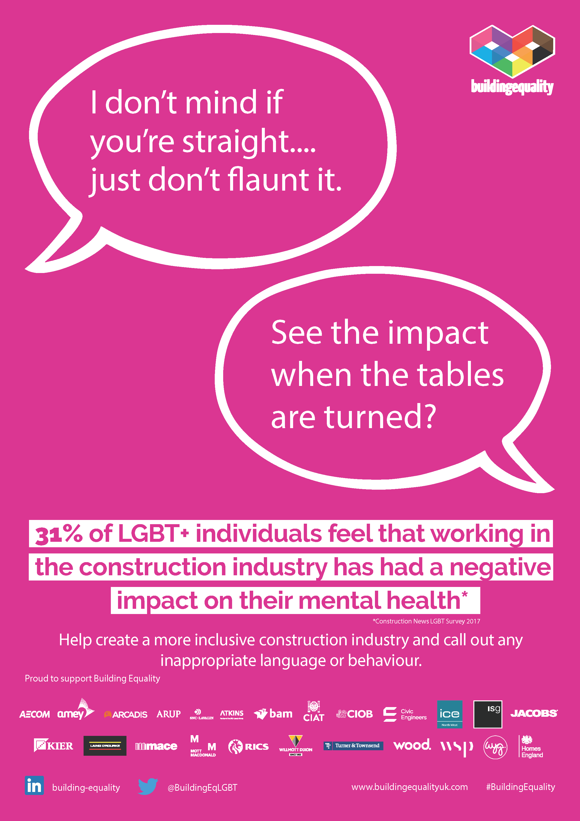
Building Equality - Poster Campaign
This poster campaign addresses the key microaggressions, and inappropriate phrases, that the LGBT+ community face on a daily basis.
We have responded to these to create an understanding of the meaning behind these terms and phrases, to both educate on the impact that they can have and to highlight exactly why they are inappropriate.
Notes:
One of Building Equality’s main objectives is to raise awareness and address key LGBT+ matters
One way in which we have done this is thorough a poster campaign.
We developed the poster campaign to educate our workforces both on site, and in offices, on the use of inappropriate language and behaviour, and to highlight the effects this can have on individuals.
It was taking those everyday microaggressions, turning them on their head in some instances, and highlighting with statistics the affect these types of comments can have on people.

Slide 22
Being LGBT+ [Or Ally] – My story
Why equality, diversity and inclusion matter to me?
INSERT YOUR OWN IMAGE
DELETE THIS BOX

Slide 23
Why equality, diversity and inclusion matter to me?
[Presenter to complete this slide, this is a very personal disclosure so the headings are purely some ideas of topics you might want to talk about. Disclosure can be as detailed or vague as you feel comfortable with]
Early experiences / influences
Struggles
Self discovery
Positive experiences
Coming out
Now and the future
Role Models
First time you felt proud
Phobias and abuse
Experience in the LGBT+ community
School
Work
Relationships
Notes:
Provide real examples once toolbox talk has been used – this will help others with their personal page.

Slide 24
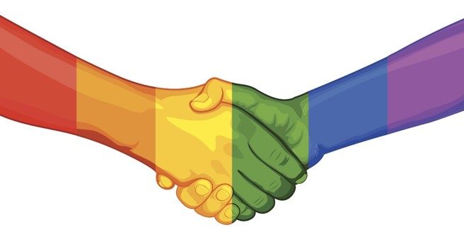
Supporting LGBT+ inclusion

Slide 25

Be an Ally
What is an Ally:
‘a person who supports equal civil rights, gender equality, LGBT social movements, and challenges homophobia, biphobia and transphobia.’
– Bernardo’s
How can you support:
Educating and empowering yourself
Listening
Being visible and challenging
Influencing others
Going beyond just LGBT+
Notes:
What can you do to support as an ally?
Allies help to create a more inclusive, understanding and welcoming environment for LGBT+ colleagues.
Through your personal and professional lives, you can help to ensure that the Construction industry is truly inclusive.
Being an ally is about being an active colleague or supporting someone else.
If we want to live in a world where people are accepted without exception, we all need to be part of the solution
1. Educate and empower yourself
Doing some research, reading up online and learning a little more about the LGBT community is a great place to start. Even if you’re part of the community, find out about people whose sexual orientation or gender identity differs to your own. Confront your own assumptions, prejudices, and bias. Google, YouTube and the LGBT media are your friends! Getting the language right can sometimes feel intimidating, so why not start with our Glossary of Terms?
2. Listen
As allies to each other, we have to be able to listen, ask how someone is doing and be aware that other people’s lives and experiences will be completely different to our own, especially in terms of discrimination and prejudice. Remember that just because someone has come out to you, they might not be out to everyone. Be respectful to each other and enjoy learning about all the differences and diversity in the communities around us.
3. Be visible and challenge
Be loud, visible and proud Ally. When you hear people making negative comments or using hurtful or abusive language towards LGBT people, challenge it.
If it’s online, report it. Be visible wear a lanyard, join a pride parade, go to a protest.
4. Influence others
Think about the opportunities you have to share the meaning of being an LGBT+ Ally. Whether it’s a conversation with friends, family or colleagues, organising a ‘lunch and learn’ at work, sharing a LinkedIn post or putting up a poster. Use the platforms you have to amplify the voices of LGBT communities and share other people’s stories.
5. Being an ally goes beyond just LGBT
It’s important to remember that people have lots of different elements to their identities, their intersectionality – someone might be bisexual and also black, Asian and minority ethnic (BAME), or trans and Catholic, gay and disabled, non-binary and dealing with a mental health issue. This may mean they suffer multiple levels of discrimination in their life. Being an ally is about listening to and learning from someone else's experiences and showing your support for them.
There is much more to being an ally and many different ways you can show your support.
For LGBT History Month next year we will be releasing our LGBT+ Allies Toolbox Talk Module.

Slide 26
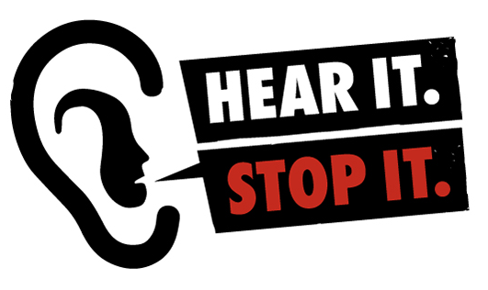
Don’t be a bystander
Remember:
Don’t be a bystander – call out inappropriate language or behaviour
Respect and support all your peers equally
Take the Pledge:
Each commitment to speak up for LGBT rights and equality helps create a world where everyone, everywhere can be themselves
Join 19,653 supporters who have sign so far
Everyone has the right to present their true selves without fear of discrimination or intimidation.
Notes:
Bullying, intimidation and the use of inappropriate language is something we all come across in our lives. The effect of this language can have huge and damaging effects on the individuals lives, their mental health, their home life, families and their ability to work
Building Equality, [client site], [member company] and this site will not tolerate bullying, harassment and the use of inappropriate language at any point, at any time.
Building Equality supports diverse workforce in all its forms including age, ability, gender, sexual orientation, gender identity, ethnicity, religious beliefs, cultural heritage and all the protected characteristics

Slide 27

Questions?

Slide 28
Support and resources
Presenter
[Presenter Name]
[Presenter Job Title]
[Presenter Contact]
Company / Organisation EDI/HR Lead
[Contact Name]
[Contact Job Title]
[Contact Contact]
Company / Organisation LGBT+ network
[Network Name / Contact]
Building Equality
https://www.linkedin.com/company/building-equality
https://twitter.com/buildingeqlgbt
www.buildingequalityuk.com
Resources, support and events
http://lgbt.foundation
http://theproudtrust.org
www.stonewall.org.uk
www.genderbread.org
www.supplychainschool.co.uk
Confidential helplines
LGBT Foundation – 0345 3 30 30 30
Samaritans – 116 123

Slide 29


