Slide 1
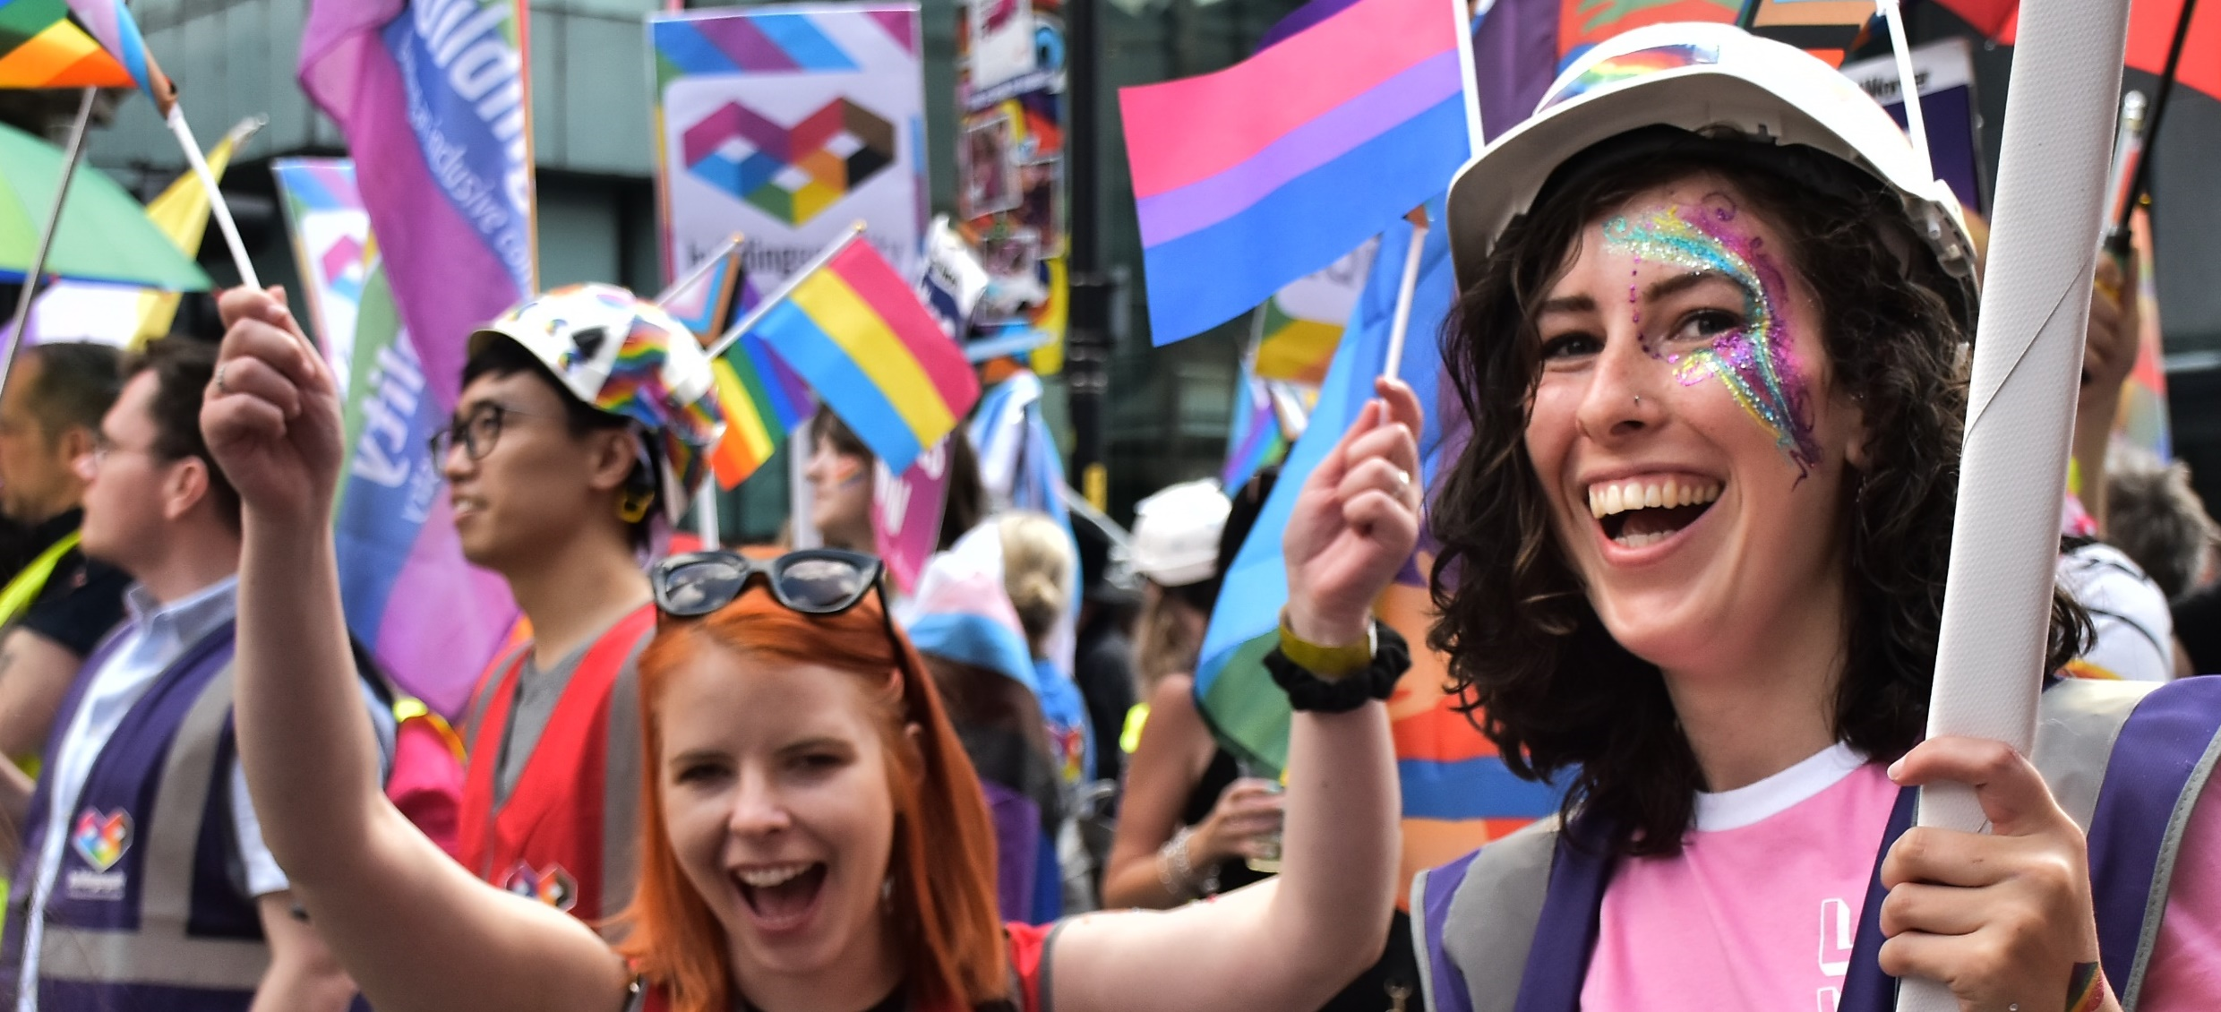
Building Equality is an alliance of construction consultants, engineers, developers, contractors, and institutions who are passionate about working together and harnessing our collective power to drive LGBTQIA+ inclusion in the construction industry.
– Creating wholly welcoming and supportive workplaces
TRANS ALLYSHIP TOOLBOX TALK
Notes:
Building Equality is an alliance of construction consultants, engineers, developers, contractors, and institutions who are passionate about working together and harnessing our collective power to drive LGBTQ+ inclusion in the construction industry. This is the ethos of Building Equality.
Our vision is to have an industry that is wholly welcoming, inclusive and supportive of LGBTQ+ individuals.
And we have presence across the UK, with over 50 organisations from the industry regularly participating in joint initiatives to drive LGBTQ+ inclusion.
Education is key to our success. We believe in actively educating on key LGBTQ+ issues and messages.
From our last toolbox talk, we have shifted the focus from what we shouldn’t do, to what we can do - to create real and lasting positive change.

Slide 2
Building Equality is an alliance of construction consultants, engineers, developers, contractors, and institutions who are passionate about working together and harnessing our collective power to drive LGBTQ+ inclusion in the construction industry.
– Creating wholly welcoming and supportive workplaces
TRANS ALLYSHIP TOOLBOX TALK
Notes:
Building Equality is an alliance of construction consultants, engineers, developers, contractors, and institutions who are passionate about working together and harnessing our collective power to drive LGBTQ+ inclusion in the construction industry. This is the ethos of Building Equality.
Our vision is to have an industry that is wholly welcoming, inclusive and supportive of LGBTQ+ individuals.
And we have presence across the UK, with over 50 organisations from the industry regularly participating in joint initiatives to drive LGBTQ+ inclusion.
Education is key to our success. We believe in actively educating on key LGBTQ+ issues and messages.
From our last toolbox talk, we have shifted the focus from what we shouldn’t do, to what we can do - to create real and lasting positive change.

Slide 3
Purpose of the Toolbox Talk
Please hide this slide before beginning your presentation.
This resource is a full Building Equality Trans Allyship Toolbox Talk.
This resource is intended to be used as the presenter sees necessary - in its entirety or in sections.
For example: we recommend you always use section 1 as the introduction of your talk – to introduce terminology and to provide the foundations of your talk.
However, you may do a talk on Misconceptions using section 5, for example.
Which slides and sections you use are down to the time limit available, the intended audience and intended message.
There are also many interactive elements to the toolbox talk, which you could use on their own as inclusion moments.
We have developed a support pack to supplement this Toolbox Talk, which covers FAQs, resource and recommendations as well as a glossary. To assist presenters we have prepared a detailed script in the slide notes.
This toolbox talk has been co-developed by Building Equality Members: AECOM, Mott McDonald, Dyer & Butler, WSP & BDP

Slide 4
1
An Introduction to Inclusive Language
2
What’s Going on with Transgender Rights?
3
Why is Inclusivity Important at Work?
CONTENTS
4
Lived Experience Stories
5
Misconceptions
6
Questions, Support & Resources

Slide 5
1
An Introduction to Inclusive Language
2
What’s Going on with Transgender Rights?
3
Why is Inclusivity Important at Work?
CONTENTS
4
Lived Experience Stories
5
Misconceptions
6
Questions, Support & Resources

Slide 6
1
An Introduction to Inclusive Language
2
What’s Going on with Transgender Rights?
3
Why is Inclusivity Important at Work?
CONTENTS
4
Lived Experience Stories
5
Misconceptions
6
Questions, Support & Resources

Slide 7
1
An Introduction to Inclusive Language
2
What’s Going on with Transgender Rights?
3
Why is Inclusivity Important at Work?
CONTENTS
4
Lived Experience Stories
5
Misconceptions
6
Questions, Support & Resources

Slide 8
1
An Introduction to Inclusive Language
2
What’s Going on with Transgender Rights?
3
Why is Inclusivity Important at Work?
CONTENTS
4
Lived Experience Stories
5
Misconceptions
6
Questions, Support & Resources

Slide 9
1
An Introduction to Inclusive Language
2
What’s Going on with Transgender Rights?
3
Why is Inclusivity Important at Work?
CONTENTS
4
Lived Experience Stories
5
Misconceptions
6
Questions, Support & Resources

Slide 10
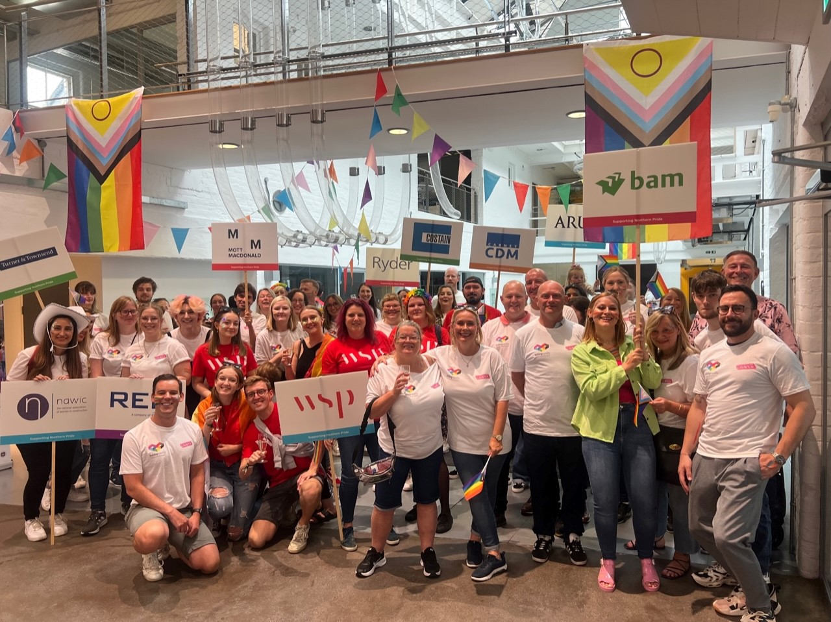
An Introduction to Trans Inclusive Language
*We use the word ‘trans’ as an umbrella term to include anyone whose gender does not solely align with the gender they were assigned at birth. ​

Slide 11
Language
Language is always evolving and changing.
Don’t be scared to ask questions – as long as they are well-intentioned.
Trans and non-binary people are not a source or font of all knowledge.
We all need to expand our knowledge and respect one another.
Notes:
Language is always evolving and changing.
Don’t be scared to ask questions – as long as they are well-intentioned. We all make mistakes, with language or otherwise, what is key is that we learn from our mistakes. Don't make a big deal if you make a mistake - apologise or say "thank you for correcting me“ and move on.
Trans and non-binary people are not a source or font of all knowledge. Every person is unique and has different and individual experiences, so the way you refer to someone should be guided by them.
Being trans is an experience unique to each person, just as cisgender people have different relationships with gender and in relation to masculinity, femininity, or lack of.
We all need to expand our knowledge and respect one another. Use your knowledge to educate and call in others when needed.

Slide 12
A
B
C
D
E
F
G
H I
J
K
L
M
N
O
P
Q
R
S
T
U
V
X
Y
Z
LGBT+ / LGBTQ+ / LGBTQIA+ / LGBTQIA2S+
The abbreviation LGBTQIA2S+ stands for:
Lesbian
Gay
Bi or Bisexual
Trans or Transgender
Queer or Questioning
Intersex
A* spectrum, including Asexual, Aromantic, Agender
2 Spirit.
This term is used to refer to a wide range of gender identities and sexual orientations that are constantly changing and evolving.
In this toolbox talk, we will use the term LGBTQ+ as shorthand.
GLOSSARY
Notes:
The acronym LGBTQIA2S+ stands for Lesbian, Gay, Bisexual, Transgender, Queer or Questioning, Intersex, Asexual and Two Spirit. The + signifies other identities.
Lesbian is used to describe a woman who is attracted to other women.
Gay is used to refer to a man who is attracted to other men.
Bi or bisexual is used to refer to someone who is attracted to people of more than one gender.
Trans or Transgender is an umbrella term used to describe individuals whose gender identity or expression does not match the gender they were assigned at birth.
Queer has been reclaimed by some in the LGBTQ+ community who don’t identify with traditional categories around gender identity and sexual orientation. This is an important distinction, some in the LGBTQ+ community may describe themselves as queer but this can still deemed a slur if used by someone outside the community.
Questioning refers to people who are exploring their gender identity or sexual orientation.
Intersex refers to people who have physical characteristics that do not fit into the traditional definitions of male or female.
'A* spec' or 'A* spectrum' is us to describe people who do not experience (or experience reduced and/or fluxuating) connection to the concepts of sexuality, romance, and/or gender.
Asexual, or Ace, is used to describe people who do not experience (or experience reduced and/or fluxuating) connection to sexual attraction. Aromantic, or Aro, is used to describe people who do not experience (or experience reduced and/or fluxuating) connection to romance. Agender is used to describe people who do not experience (or experience reduced and/or fluxuating) connection to gender.
Two Spirit is a term used by some Indigenous North Americans to describe people who have both masculine and feminine spirits.
The + signifies other identities - this ensures that we will always be inclusive of all identities, to make all feel welcomed.
In a perfect world we would use another word, rather than an a ‘+’ or an acronym. Using the right labels can be tough and can also limit or misdirect people from the truth. There are also more ways in which people can identify, than have been included here.
Our identities are constantly evolving and changing and it is essential to be respectful of everyone's individual identity and not make assumptions about someone's gender identity or sexual orientation.

Slide 13
A
B
C
D
E
F
G
H I
J
K
L
M
N
O
P
Q
R
S
T
U
V
X
Y
Z
Gender:
Gender can either be used to refer to a person's own sense of their own gender or the gender that is assigned at birth based on visible sex characteristics. Gender is a social construct informed, influenced, and impacted by culture. As such, each person's idea of their own gender will likely be unique.
Cis / Cisgender:
Somebody whose gender completely aligns with the gender they were assigned at birth.
Trans / Transgender:
A term used to describe a person whose gender does not solely match with the gender they were assigned at birth. Trans people may describe themselves using a wide variety of terms, including (but not limited to) agender, bi-gender, gender-fluid, genderqueer, gender-variant, non-binary, third gender, trans man, trans masculine, trans woman, trans feminine, transgender, and two-spirit.
GLOSSARY

Slide 14
A
B
C
D
E
F
G
H I
J
K
L
M
N
O
P
Q
R
S
T
U
V
X
Y
Z
Agender:
Denoting or relating to a person who does not identify as any particular gender, some agender people describe it as having a “lack of gender,” while others describe themselves as being gender neutral.
Ally / Advocate:
A (typically straight and/or cisgender) person who supports the LGBTQ+ community. People in the LGBTQ+ community can also be allies to those with other identities in the community.
GLOSSARY

Slide 15
A
B
C
D
E
F
G
H I
J
K
L
M
N
O
P
Q
R
S
T
U
V
X
Y
Z
GLOSSARY
Deadnaming:
Calling someone by their old name after they have told you to use a different name for them. This term is often associated with trans people who have changed their name as part of their transition.

Slide 16
A
B
C
D
E
F
G
H I
J
K
L
M
N
O
P
Q
R
S
T
U
V
X
Y
Z
Gender identity:
A person’s innate sense of their own gender, which may or may not correspond to the gender they were assigned at birth.
Gender expression:
The way a person expresses aspects of their gender, including clothing, hairstyles, makeup, behaviour, and mannerisms.
GLOSSARY

Slide 17
A
B
C
D
E
F
G
H I
J
K
L
M
N
O
P
Q
R
S
T
U
V
X
Y
Z
Gender dysphoria:
Used to describe when a person experiences discomfort or distress because there is a mismatch between their gender and the gender they were assigned at birth.
Gender euphoria:
Used to describe the elation that someone feels when their gender is affirmed, e.g., someone uses the correct pronouns for them.
Gender incongruence:
Used to describe the dissonance that trans people have between their gender and the gender they were assigned at birth.
GLOSSARY

Slide 18
A
B
C
D
E
F
G
H I
J
K
L
M
N
O
P
Q
R
S
T
U
V
X
Y
Z
GLOSSARY
Intersex:
This term refers to people who are born with any of several sex characteristics including chromosome patterns or genitals that do not fit within the typical binary societal definition of what constitutes male or female bodies.​
Notes:
This term refers to people who are born with any of several sex characteristics including chromosome patterns or genitals that do not fit within the typical binary societal definition of what constitutes male or female bodies.
In this situation, parents are often asked to choose which gender they want their child to be, which may or may not correlate with how that person feels later in life.

Slide 19
A
B
C
D
E
F
G
H I
J
K
L
M
N
O
P
Q
R
S
T
U
V
X
Y
Z
Misgendering:
Intentionally or unintentionally referring to a person or using language to describe a person that doesn’t align with their gender. For example, referring to a trans woman who uses she/her pronouns as “he” or calling her a “guy”.​
GLOSSARY

Slide 20
A
B
C
D
E
F
G
H I
J
K
L
M
N
O
P
Q
R
S
T
U
V
X
Y
Z
Non-Binary:
A person who does not identify solely with either male or female. This is used both as an identity in its own right and as an umbrella term to encompass a variety of other identities.​
GLOSSARY

Slide 21
A
B
C
D
E
F
G
H I
J
K
L
M
N
O
P
Q
R
S
T
U
V
X
Y
Z
GLOSSARY
Pronouns:
A word used to refer to a person in conversation - for example, ‘he’ or ‘she’. Some people may request that others refer to them using gender neutral pronouns, for example ‘they’ and ‘ze’.

Slide 22
A
B
C
D
E
F
G
H I
J
K
L
M
N
O
P
Q
R
S
T
U
V
X
Y
Z
Transition:
The steps a person may take to express their gender so they feel a greater congruence between their gender and the gender they were assigned at birth. This can include coming out, changing name, descriptors and pronouns, and altering appearance. Transition can also include medical and surgical procedures. Each person's transition will be different and may include any number of the steps listed.​
GLOSSARY

Slide 23
A
B
C
D
E
F
G
H I
J
K
L
M
N
O
P
Q
R
S
T
U
V
X
Y
Z
Xenogender:
Xenogender is an umbrella term for non-binary gender identities that cannot be fully described through their relation to concepts typically used to describe gender such as male, female, man, woman, masculinity, femininity, androgyny, or neutrality. Instead, xenogenders can best be described through how they relate to things or beings that most individuals don't think of as having to do with gender, such as animals, plants, things, or concepts.
GLOSSARY
Notes:
Xenogender is an umbrella term for non-binary gender identities that cannot be fully described through their relation to concepts typically used to describe gender such as male, female, woman, man, masculinity, femininity, androgyny, or neutrality. Instead, xenogenders can best be described through how they relate to things or beings that most individuals don't think of as having to do with gender, such as animals, plants, things, or concepts.
Xenogender individuals often have a strong understanding of how their gender feels to them, however they often find that there aren't any words for their experiences. In order to fill that gap xenogender individuals often describe their gender through metaphors, by saying their gender is like, is influenced by, or shares qualities with something else.

Slide 24
Why are pronouns important?
they
them
he
him
It is a basic gesture of respect to call someone by the correct pronouns.
Regardless of intent, using the wrong pronouns to refer to someone can have a huge impact on a person’s wellbeing.
It is impossible to know which pronouns someone uses by looking at them, but this doesn’t stop people making assumptions.
You might be confident that people will make the correct assumption about you, but this isn’t about you.
If you're not sure of someone's pronouns, what could you do?
she
her
ze
hir
all
pronouns
they
she
it
its
xe
xyr
Notes:
It is a basic gesture of respect to call someone by the correct pronouns.
Regardless of intent, using the wrong pronouns to refer to someone can have a huge impact on a person’s wellbeing. Your “small mistake” could be part of a larger pattern, alongside other people actively choosing to continue misgendering someone despite being corrected.
It is impossible to know which pronouns someone uses by looking at them, but this doesn’t stop people making assumptions. As an ally, an easy way to create a safe and trans inclusive space is to interrupt those assumptions by including your pronouns in your introductions or your email signature or wearing a pronouns badge.
This might feel awkward at first, especially if you’re confident that people will make the correct assumption, but this isn’t about you. It can feel very isolating to be the only person regularly sharing pronouns. It also demonstrates your support which helps others feel included.
If you're not sure of someone's pronouns, what could you do?
You could ask them, or refer to them by name. Also, be aware that someone might not want to share their pronouns with you.

Slide 25
TRANS
NON-BINARY
GENDERQUEER
AGENDER
GENDERFLUID
INTERSEX
LGBTQIA+
FLAGS
See full deck for more information on the flags
Notes:
Trans - The colours used at the top and bottom represent the traditional light blue used for boys. The next stripes are light pink traditionally used for girls. The white stripe in the centre represents people who are transitioning, have no gender, are gender neutral or non-binary.
Non-Binary - The four horizontal stripes of yellow, white, purple, and black are symbolic for Non-Binary peoples’ experience. Yellow represents those whose gender falls outside of the binary. White represents people with many or all genders. Purple represents those whose gender identity falls somewhere between male and female. Black represents people who are without a gender.
Genderqueer - The flag is made up of lavender, white and green stripes. Lavender, a mixture of blue and pink traditional male and female colours, represents androgyny. Lavender also represents the queer identity and has historically been associated with the LGBTQ+ community. White represents those who identify as gender neutral and green represents third gender identities and those who don’t identify on the traditional gender spectrum.
Agender - The black and white represents an absence of gender, with the grey representing semi-genderlessness and the green represents non-binary genders.
Genderfluid - The flag represents the fluctuations and flexibility for gender fluid people. Pink at the top represents femininity or feeling female and the blue at the bottom represents masculinity or feeling male. White represents people with many or all genders. Purple represents those whose gender identity falls somewhere between male and female. Black represents people who are without a gender.
Intersex - The intersex flag was created in 2013, using yellow and purple, as they are gender neutral colours. The purple circle is described as unbroken, about being whole and complete as well as the right for intersex people to make decisions about their bodies. Gold was used to reclaim slurs against the intersex community.
Pride Progress - In 2018 the Progress flag was created incorporating elements from the rainbow flag and the transgender flag, to bring the focus on inclusion and progress within the community. The traditional rainbow colours are used, along with a chevron made up of black, brown, light blue, pink and white, to represent people of colour, transgender people, and those living with HIV/AIDS. The intersex flag has recently been incorporated to make the Progress flag even more inclusive.

Slide 26
TRANS
NON-BINARY
GENDERQUEER
AGENDER
GENDERFLUID
INTERSEX
LGBTQIA+
FLAGS
Notes:
The colours used at the top and bottom represent the traditional light blue used for boys. The next stripes are light pink traditionally used for girls. The white stripe in the centre represents people who are transitioning, have no gender, are gender neutral or non-binary.

Slide 27
TRANS
NON-BINARY
GENDERQUEER
AGENDER
GENDERFLUID
INTERSEX
LGBTQIA+
FLAGS
Notes:
The four horizontal stripes of yellow, white, purple, and black are symbolic for Non-Binary peoples’ experience. Yellow represents those whose gender falls outside of the binary. White represents people with many or all genders. Purple represents those whose gender identity falls somewhere between male and female. Black represents people who are without a gender.

Slide 28
TRANS
NON-BINARY
GENDERQUEER
AGENDER
GENDERFLUID
INTERSEX
LGBTQIA+
FLAGS
Notes:
The flag is made up of lavender, white and green stripes. Lavender, a mixture of blue and pink traditional male and female colours, represents androgyny. Lavender also represents the queer identity and has historically been associated with the LGBTQ+ community. White represents those who identify as gender neutral and green represents third gender identities and those who don’t identify on the traditional gender spectrum.

Slide 29
TRANS
NON-BINARY
GENDERQUEER
AGENDER
GENDERFLUID
INTERSEX
LGBTQIA+
FLAGS
Notes:
The black and white represents an absence of gender, with the grey representing semi-genderlessness and the green represents non-binary genders.

Slide 30
TRANS
NON-BINARY
GENDERQUEER
AGENDER
GENDERFLUID
INTERSEX
LGBTQIA+
FLAGS
Notes:
The flag represents the fluctuations and flexibility for gender fluid people. Pink at the top represents femininity or feeling female and the blue at the bottom represents masculinity or feeling male. White represents people with many or all genders. Purple represents those whose gender identity falls somewhere between male and female. Black represents people who are without a gender.

Slide 31
TRANS
NON-BINARY
GENDERQUEER
AGENDER
GENDERFLUID
INTERSEX
LGBTQIA+
FLAGS
Notes:
The intersex flag was created in 2013, using yellow and purple, as they are gender neutral colours. The purple circle is described as unbroken, about being whole and complete as well as the right for intersex people to make decisions about their bodies. Gold was used to reclaim slurs against the intersex community.

Slide 32
TRANS
NON-BINARY
GENDERQUEER
AGENDER
GENDERFLUID
INTERSEX
LGBTQIA+
FLAGS
Notes:
In 2018 the Progress flag was created incorporating elements from the rainbow flag and the transgender flag, to bring the focus on inclusion and progress within the community. The traditional rainbow colours are used, along with a chevron made up of black, brown, light blue, pink and white, to represent people of colour, transgender people, and those living with HIV/AIDS. The intersex flag has recently been incorporated to make the Progress flag even more inclusive.

Slide 33
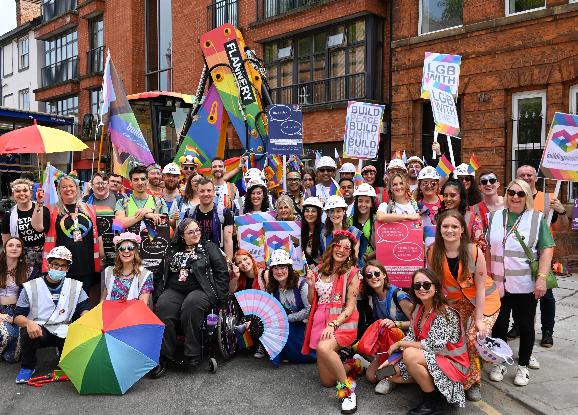
What’s Going on with Trans Rights?

Slide 34
A VERY POTTED HISTORY BEFORE THE COMMON ERA
BCE – 1900’s
THE 1900’s
2000 – 2020
2020 - 2023
Drawings depict a 'third sex'
A male body is buried in 'clothes usually reserved for women'
Hippocrates writes of eunuchs 'who perform female work, and speak like women'

Slide 35
A VERY POTTED HISTORY BEFORE THE COMMON ERA
BCE – 1900’s
THE 1900’s
2000 – 2020
2020 - 2023
Drawings depict a 'third sex'
A male body is buried in 'clothes usually reserved for women'
Hippocrates writes of eunuchs 'who perform female work, and speak like women'
Notes:
https://en.wikipedia.org/wiki/Timeline_of_transgender_history
https://en.wikipedia.org/wiki/Karl_M._Baer#/media/File:Karl_M_Baer_Geburtsregister_Arolsen.jpg
https://transgenderlawcenter.org/equalitymap
These are obviously a very limited selection of events, there are several others available. Notes to presenters: feel free to amend this section and include other events.

Slide 36
A VERY POTTED HISTORY BEFORE THE COMMON ERA
BCE – 1900’s
THE 1900’s
2000 – 2020
2020 - 2023
There are records of different genders worldwide – examples include the Hijra community in Hindu society, the Calalai, Calabai, and Bissu genders within the Bugis ethnic group in Indonesia, and the Muxe community in Mexico.
The spread of colonialism prompted stigma, erasure and discrimination against "non-traditional" genders through forced conformity to western European gender roles.
However, it is also important to note that there have been records of trans and nonbinary people throughout history in western Europe as well!
Notes:
https://en.wikipedia.org/wiki/Timeline_of_transgender_history
https://en.wikipedia.org/wiki/Karl_M._Baer#/media/File:Karl_M_Baer_Geburtsregister_Arolsen.jpg
https://transgenderlawcenter.org/equalitymap

Slide 37
A VERY POTTED HISTORY BEFORE THE COMMON ERA
BCE – 1900’s
THE 1900’s
2000 – 2020
2020 - 2023
1906 - Karl Baer becomes one of the first people to receive gender reassignment surgery and gain the right to marry
1969 – The trans community, notably Marsha P Johnson & Silvia Rivera lead the Stonewall Riots and subsequent pride movement

Slide 38
A VERY POTTED HISTORY BEFORE THE COMMON ERA
BCE – 1900’s
THE 1900’s
2000 – 2020
2020 - 2023
2011 – Chas Bono is the first post-op transgender person to appear on primetime
2017 – Laverne Cox is nominated for an Emmy for her role in Orange Is The New Black
Throughout – anti-discrimination laws for gender identity and expression are passed in several North American regions
Notes:
UK government to block Scottish gender bill - BBC News
Mapping Attacks on LGBTQ Rights in U.S. State Legislatures | American Civil Liberties Union (aclu.org)
Uganda: Living in the shadow of one of the world's harshest anti-LGBTQ laws | CNN

Slide 39
A VERY POTTED HISTORY BEFORE THE COMMON ERA
BCE – 1900’s
THE 1900’s
2000 – 2020
2020 - 2023
January 2023 – UK blocks Scotland's gender ID bill
June 2023 – 491 anti-LGBTQ+ bills in the US
June 2023 – Uganda passes one of the world's harshest anti LGBTQ+ bills
August 2023 – International Chess Federation bans trans women from competing in 'women's' events

Slide 40
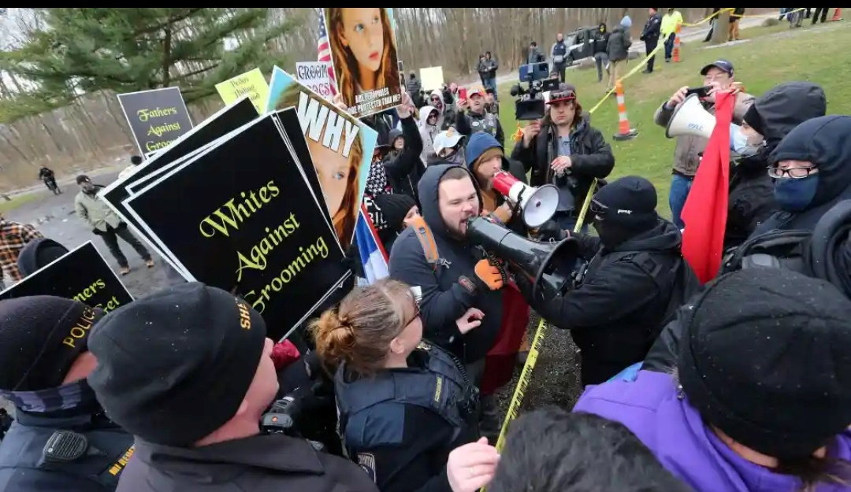
We can't let hate go unchecked
Notes:
Michael Knowles (political commentator) - Wikipedia
Migrants entering the UK illegally 'will be banned from claiming asylum from TODAY' | Daily Mail Online

Slide 41
Not popular, not legal
Notes:
Federal judge rejects Tennessee drag show ban as unconstitutional | Reuters
State laws targeting LGBTQ rights have a new foe: federal judges (nbcnews.com)
UK's Rwanda deportation plan 'unlawful,' court of appeal rules | CNN

Slide 42
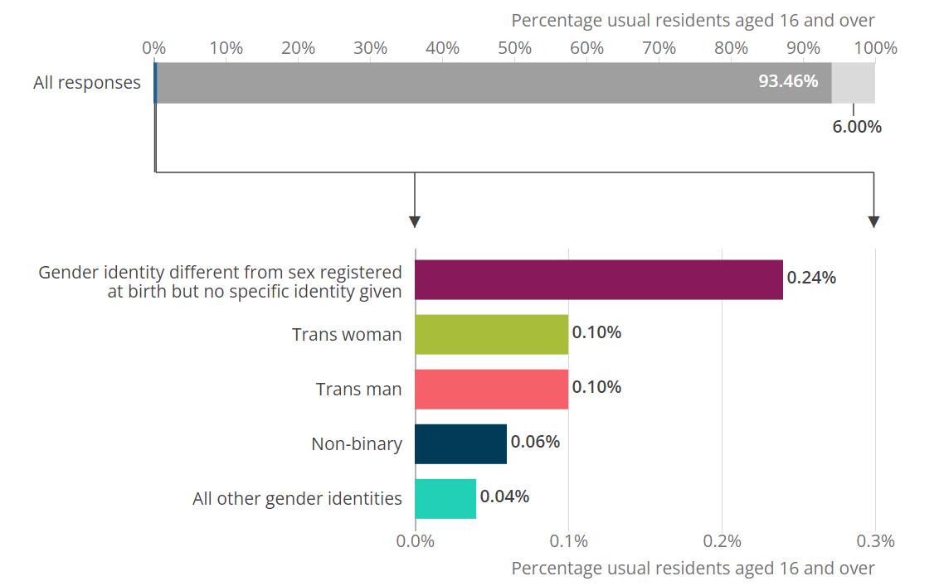
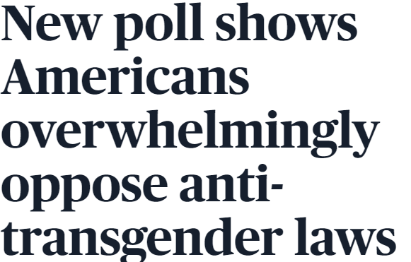
Facts & figures – don’t get distracted by the hate
Notes:
14 facts about trans lives and trans rights — TransActual
New poll shows Americans overwhelmingly oppose anti-transgender laws | PBS NewsHour

Slide 43
Why is Inclusivity at Work important?
Inclusivity fosters teamwork, appreciation, wellbeing, and many other attributes that make up a positive work environment.
Employees are treated as individuals and supported no matter what, creating a positive atmosphere beneficial to engagement.
Notes:
Inclusivity fosters teamwork, appreciation, wellbeing, and many other attributes that make up a positive work environment.
Employees are treated as individuals and supported no matter what, creating a positive atmosphere beneficial to engagement.

Slide 44
Some reflections from trans and non-binary colleagues

Slide 45
My pronouns are important to me as a trans woman because they provide clarity and prevent others misgendering me in an online environment due to my voice, in the absence of visual presentation, which can be mentally tiring otherwise.
I include my pronouns in my email signature to clarify what pronouns I want colleagues to use (as some have been unsure but don't or won’t ask).
Some reflections from trans and non-binary colleagues

Slide 46
Some reflections from trans and non-binary colleagues

Slide 47
As a trans person I am often misgendered. This has happened to me in the office and on work calls. It may seem like no big deal to someone else but personally it can really impact my day. Using my correct pronouns is a small way to help me feel included and respected.
Displaying my pronouns somewhere like my email signature really helps other people around me know how to refer to me. It is as important as knowing my name and can help me feel accepted as a trans person at work.
Some reflections from trans and non-binary colleagues

Slide 48
Some reflections from trans and non-binary colleagues

Slide 49
I had an email exchange with a former colleague who I’d never come out to or spoken to about using they/them pronouns. As part of that interaction, he sent an email introducing me to someone else and used the right pronouns for me, presumably just from checking my email signature.
It was so nice to have that happen without additional input from me. It was also a relief to be introduced with the correct pronouns. Often I’m not and it leads to awkward conversations later on.
Some reflections from trans and non-binary colleagues

Slide 50
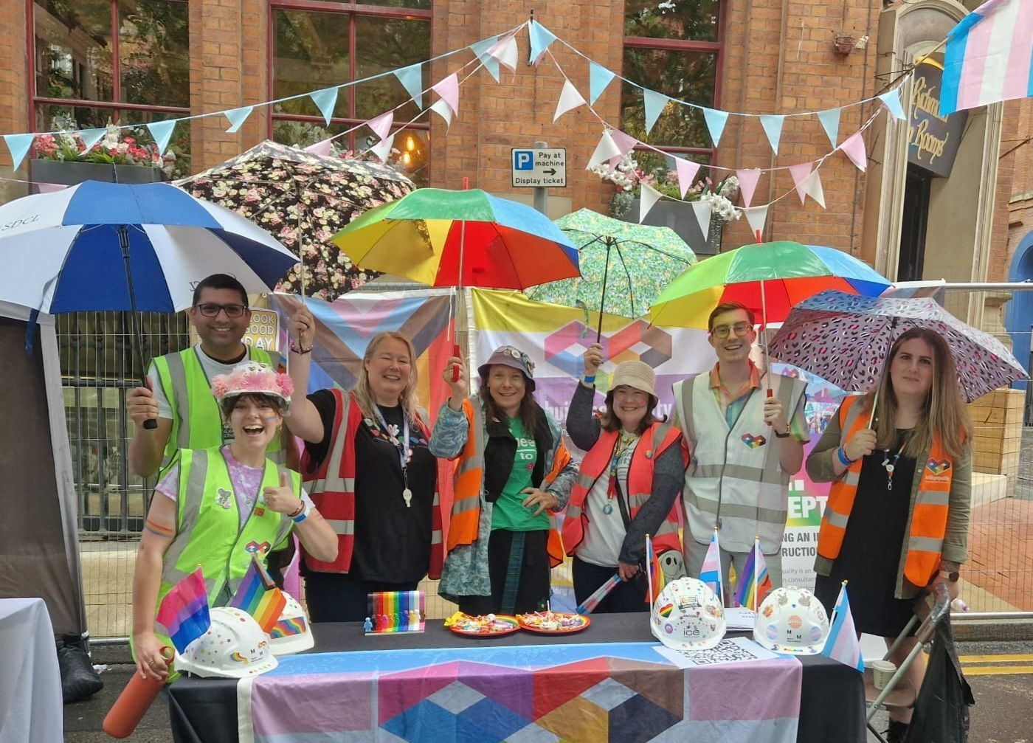
Lived Experiences
Meet some of our colleagues, friends & family to learn more about their trans experiences.

Slide 51
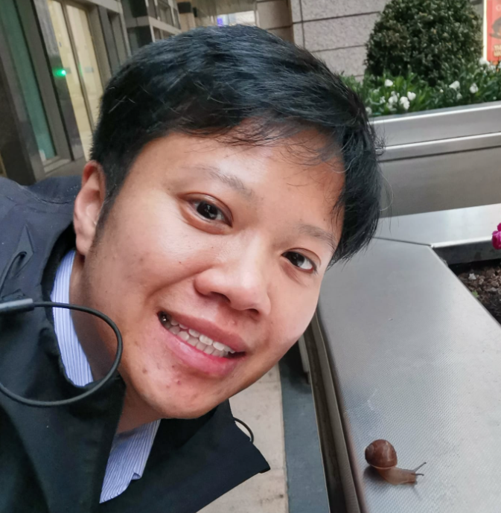
A BIT ABOUT ME
Hiro Ng BSc MSc
Procurement Lead
Dyer & Butler
Hiro.Ng@dyerandbutler.co.uk
Building Equality London Co-Chair
M Group Services Rail & Aviation EDI Co-Chair & LGBTQ+ Network Lead
I LIKE:
Travelling, Crocheting, Binging tv dramas, Learning new things, Pokémon
MY NEURODIVERSITY:
ADHD, Dyslexia & Dyspraxia
HIRO
He/Him

Slide 52
MY STORY
Growing up in Malaysia in the 90's with little to no internet access, there wasn't a word to describe how I felt about myself. I knew I was different from my peers, but I didn't understand why and couldn't find the language to express it.
The word gay, transvestite, and crossdresser were words used at the time and were meant to be derogatory. There was very little education about the LGBTQ+ community. If a person did not conform to the "heterosexual normative" crowd, they were seen as less of a person. Some even beaten into submission.
Moving to the UK for my higher education was the best thing that happened to me. With my newfound freedom, I was free to explore opportunities the world had to offer. I met people from different cultures and learnt "the western way of life" which was considered too liberal and sometimes, "out of order". It was here where I learnt the words to express myself, and realised I wasn't "broken" or socially awkward. There was a term for people like me, transgender. And this is where I met my other half, who is my rock till this very day.
HIRO
He/Him

Slide 53
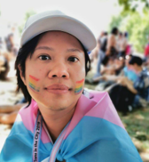
MY STORY
I graduated during the 2008 financial crisis. Unable to secure employment in the UK, I had no choice but to return to Malaysia. I then came out to my parents who struggled to accept, and misgender me till this very day. As I wasn't welcome at home and with all the stigma towards trans people in Malaysia, I fled for safety and came back to the UK, the place which accepted me, and I made my home.
I started my UK Construction career as a Quantity Surveyor at Carillion Plc in the rail sector. Stumbled into the job by a stroke of luck, I spent 3 amazing years with the team whilst socially and medically transitioning before moving to Dyer & Butler when Carillion went into liquidation. ​
My experience transitioning at work was filled with love, support and acceptance. My colleagues adjusted quickly to my preferred name and pronouns and socialised as they would with any male colleague. It was then I noticed distinctive differences in language and behaviour when a female presenting person is present in a room of men and when there wasn't. ​
Medically transitioning also provided me more confidence to be myself. I felt comfortable in my own skin as my external appearance started to match how I felt internally.
HIRO
He/Him

Slide 54
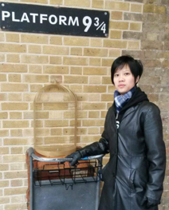
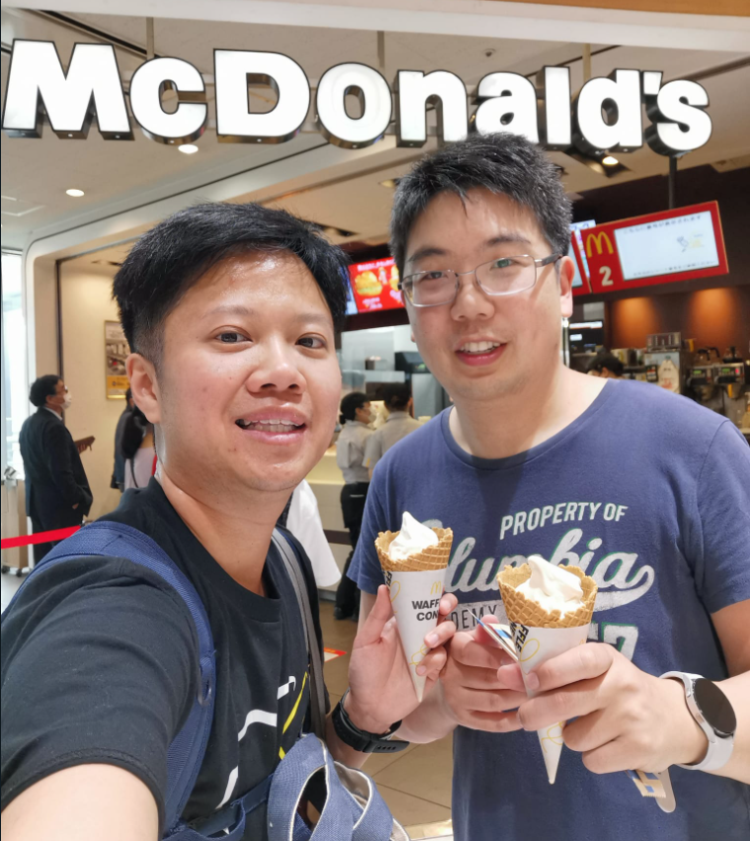
MY STORY
As I was passing in society and when I joined Dyer & Butler, I decided to stay stealth. At the time, I just wanted to live life as a male presenting person and not worry about what others thought of me if they knew I was trans. ​
It was not until few of us colleagues came together to start the EDI group in 2021, did I see the gravity to start being a visible role model and advocating. I believe this helped alleviate a lot of preconceived assumptions about transgender people as I was already known to my colleagues. ​
I continue to educate myself on EDI, LGBTQ+ matters, the trans community and intersectionality by being part of Building Equality and other community groups. Always at the ready to share my story and promote advocacy.​
Be kind to yourself,
It does get better.
HIRO
He/Him

Slide 55
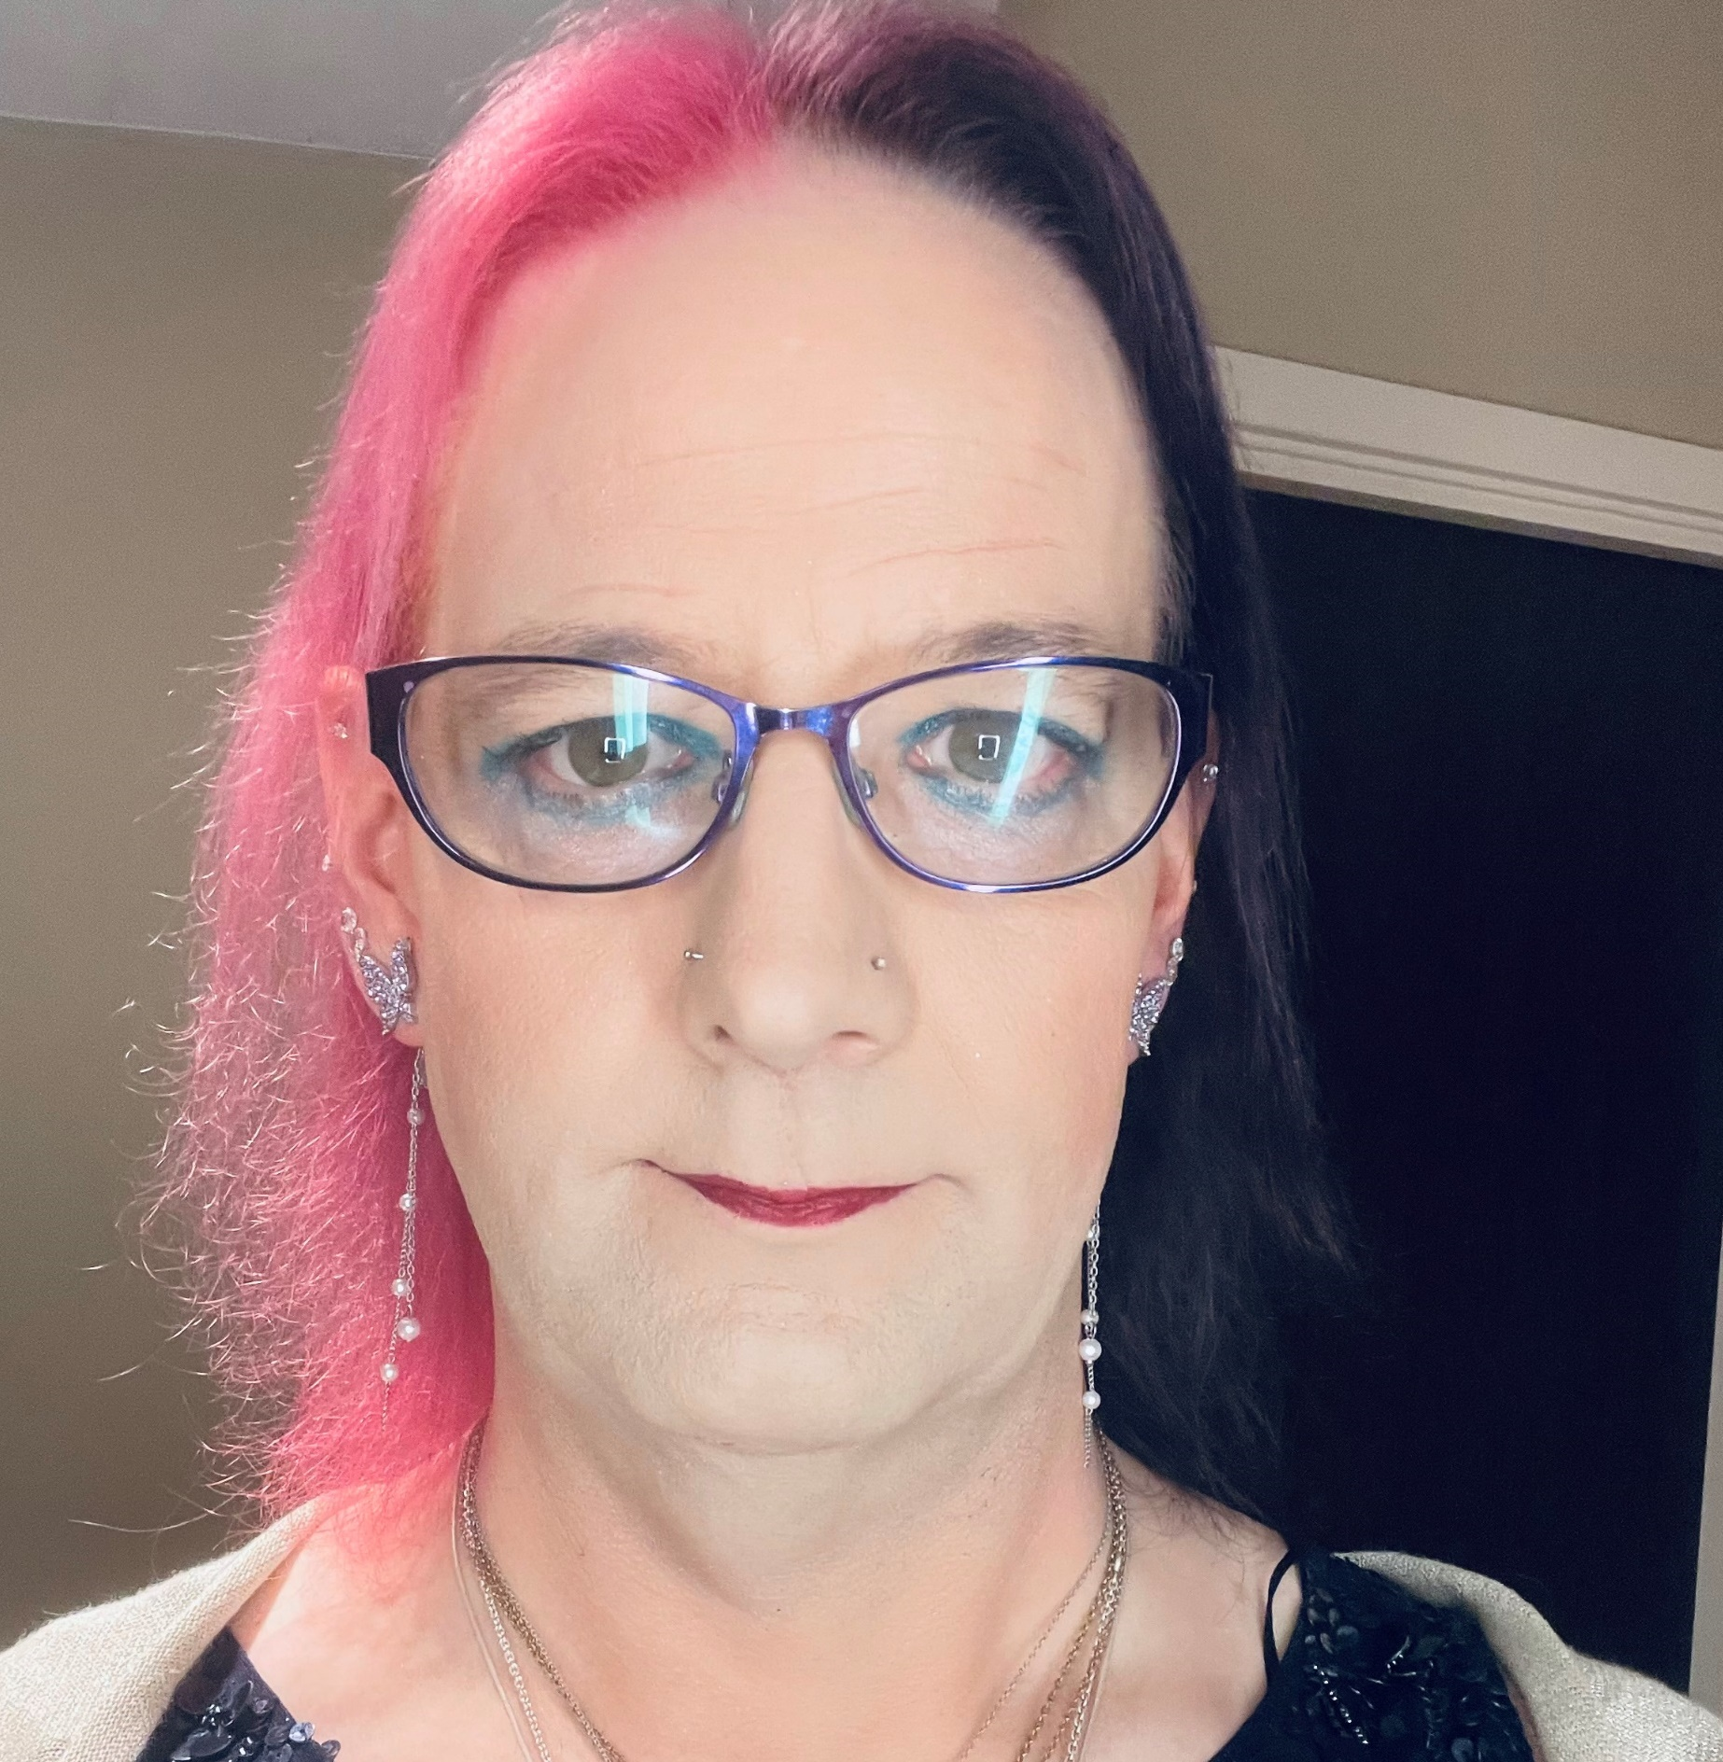
A BIT ABOUT ME
Katie Elouise Shepherd
Senior Civil Engineer
Mott MacDonald
katie.shepherd@mottmac.com
Sheffield Office Advance Champion
Building Equality Sheffield City Region Chair
Building Equality National Executive member
MY JOURNEY:
I’ve been a been a visibly “Out” transgender woman and part of Building Equality, though knew I was me for 38 years before ”Coming out”.
KATIE
She/Her

Slide 56
MY STORY
I’ve been with Mott MacDonald for over 23 years and generally stayed within Highways, I’m the Signing & Lining person for our Northern Region and based in Sheffield, South Yorkshire in the UK (over the border from Manchester).
Day to day role includes the technical side of all the road markings and associated road signs.
Developing my own knowledge of equality, diversity and inclusion and how that can be factored in making highway and public realm spaces safer for all.
Figuring out who I am, who I’d like to be and wish to achieve, whilst learning to adapt to the ongoing physical and psychological issues.
Currently spending my spare time out split between BE / SAYiT & training 25-50k in preparation for my Ultra 100k trek challenges.
KATIE
She/Her

Slide 57
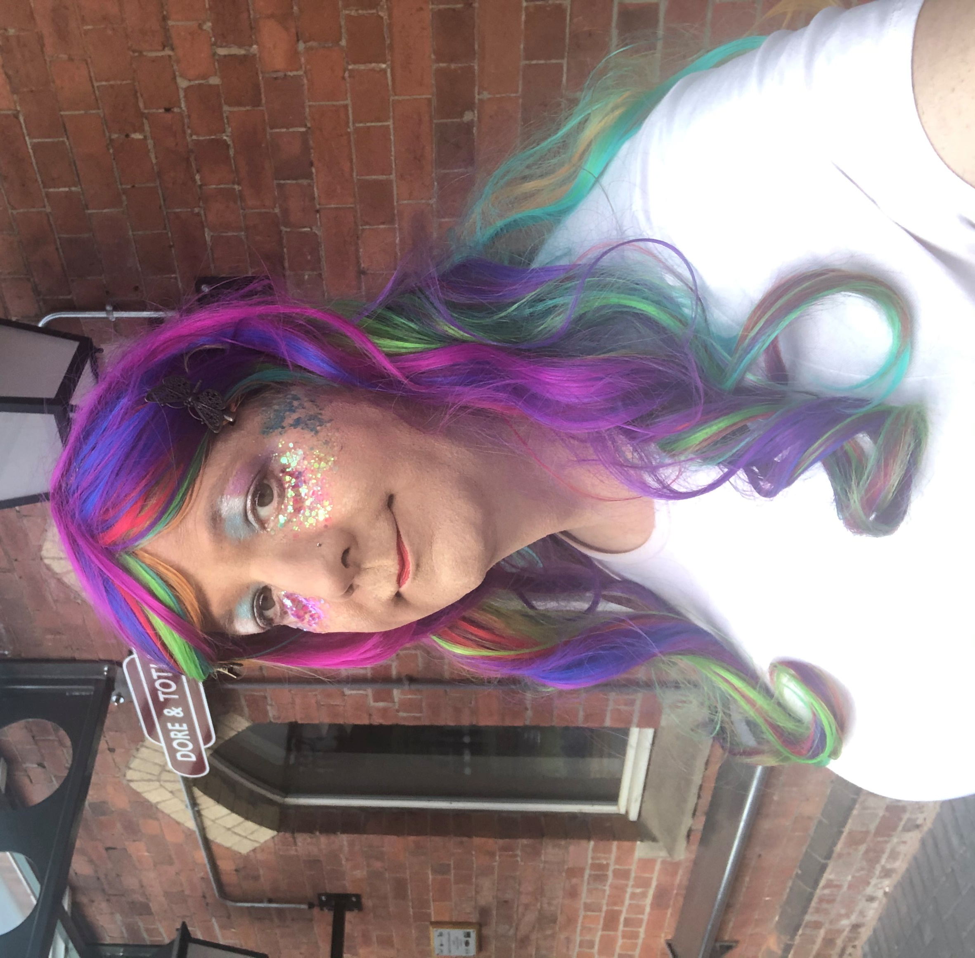
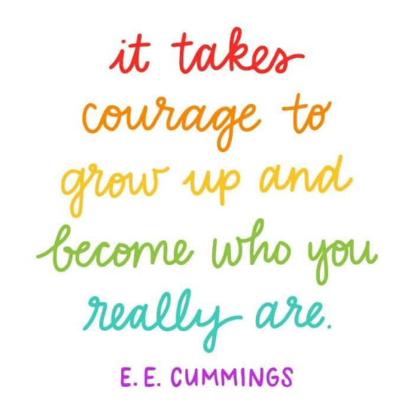
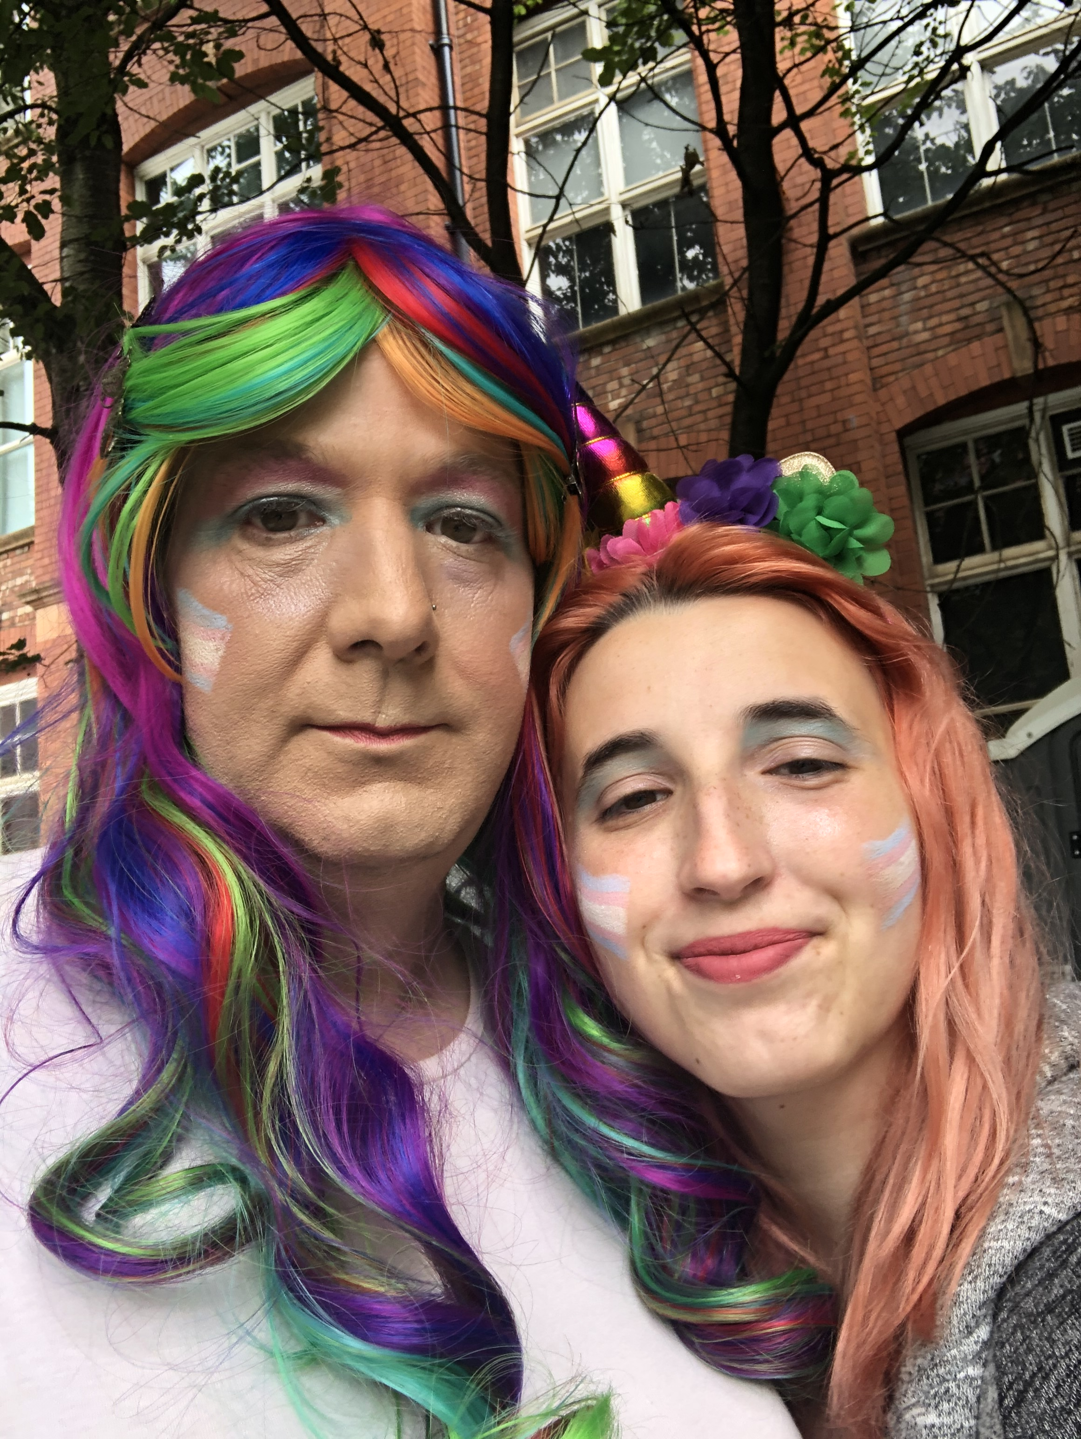
How Do You Describe Yourself?
I would describe myself as a woman.
I’m just me, I’m not trying to “pass” though would like to one day, I’m doing this to be my true self, and just happy to finally be me, I just want to be accepted for me and as a woman in the office and wear whatever I am comfortable with, generally skirts or dresses, which I appreciate may be an issue for some of my colleagues who have known me for a long time.
I will forever and always be a parent to my four, though I’m a Grandma to both of my Grandchildren, and I’m conscious that I’m not trying to replace their Mum.
I want people to know that I'm still me. I'm the same person as always on the inside and in hindsight I would have liked to give people at work more guidance on what they could say.
KATIE
She/Her

Slide 58
MY INSPIRATION
“Never forget how far you’ve come.
Everything you have gotten through.
All the times you have pushed on even when you felt you couldn’t.
All the mornings you got out of bed no matter how hard it was.
All the times you wanted to give up but you got through another day.
Never forget how much strength you have developed along the way.”
“When a flower doesn’t bloom, you fix the environment in which it grows, not the flower.”
“You seriously have no idea what people are dealing with in their personal life.
So just be nice, its that simple.”
“Maybe not today
maybe not tomorrow,
or even in a year,
you will look back at your journey and say with relief…
I made it.”
KATIE
She/Her

Slide 59
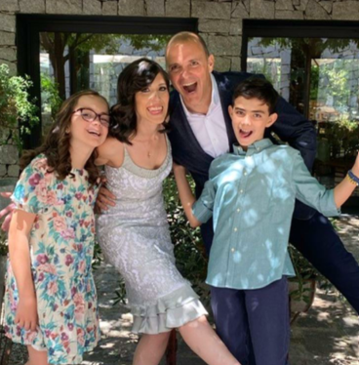
Our Story
In December 2011, my non-identical twin children, Santiago and Alicia, were born in Santiago, Chile. 29-weeks premature, it was a high-risk birth and the twins were in incubators for seven weeks after being born. In the end, thanks to all the doctors and nurses, everything went very well.
During the pregnancy, the gynaecologist confirmed from the ultrasounds that two little boys were coming. We decided to name the first to be born Joaquín and the second Santiago. We always thought we had two boys, and that's how we started our family life.
In 2019, we moved back to Spain, our country of origin and the twins started their third year of primary education at their new school in September.
Then, in mid-November 2019, when the children were seven years old, Alicia approached her tutor at school and came out to her as a girl. She told her teacher that she wanted to come to school dressed in the girl’s uniform from the beginning of her fourth year.
Joaquin & Alicia

Slide 60
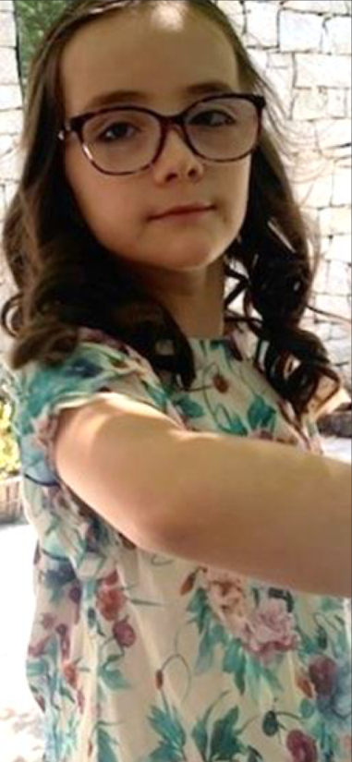
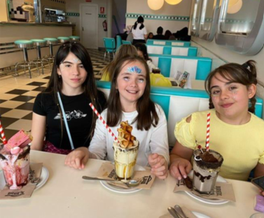
OUR STORY
Her teacher immediately informed us and, at first, it was a massive shock. From the early years of childhood Alicia had had “socially” feminine tastes like playing with dolls, dressing up as a princess. We’d wondered if we might have a gay son but we’d never imagined that we might have a daughter.
My uncle is gay, as is my middle brother and I have seen society start to more broadly accept their sexuality (although still with certain prejudices), but I know that transgender people still face many obstacles.
I remember the first thing I did was google “transgender” and “transsexual”. At that time, I mostly found stories of stigma and marginalisation. As a father, I was so afraid for her. I worried that she would be miserable.
Joaquin & Alicia

Slide 61
OUR STORY
Despite the shock, and the fear, we spoke with our daughter about the reasons for making the change. We saw how natural and right it felt for her, and we decided the best thing for us to do, the thing that made the most sense, would be to support her throughout the process. When we told her brother Santiago about it, he said: “Well, it was about time!”
We used the pandemic to change her clothing, let her hair grow, put earrings on, and she chose her new name: Alicia
The critical day was September 8, 2020. Alicia appeared at school before her classmates in her girl's uniform. In the first minutes of the class, she explained that she was no longer Joaquín, that she was a girl, and her name was now Alicia. The acceptance her classmates and friends showed was incredible: total acceptance, zero problems. Today, three years later, Alicia is the delegate of her class, voted for by her classmates.
We’re currently attending the Gender Identity Unit (UIG) of the Ramón y Cajal Hospital of the public health system. This public medical service was created back in 2007. We meet with a multidisciplinary team of paediatricians, endocrinologists, surgeons, psychologists, psychiatrists and sociologists there, where we have checks and follow-ups but no primary treatments yet.
Joaquin & Alicia

Slide 62
MY CONCLUSIONS
The support, understanding and love from our family, friends and the school community has been extraordinary. We haven't had any social problems at all. No issues with any stakeholders in Alicia's life. We have a happy family life with our son and daughter, and Alicia lives an everyday life as an 11-year-old girl.
The conclusions I’ve taken away from these experiences as a caring father are:
It’s not about ideology – it’s nature itself. In 2015 I would have denied that a person could decide on their gender assignment. My daughter has taught me just the opposite.
Each person and each case is different. Being transgender is not a black and white experience – there’s a very wide greyscale.
People react better than you think. I was afraid for Alicia but everyone in her life has supported her from the beginning with understanding and love.
Happiness. Although I was afraid for her, and I know the path forward may not always be easy, I’m certain that Alicia will grow up to be a happy woman.
Joaquin & Alicia

Slide 63
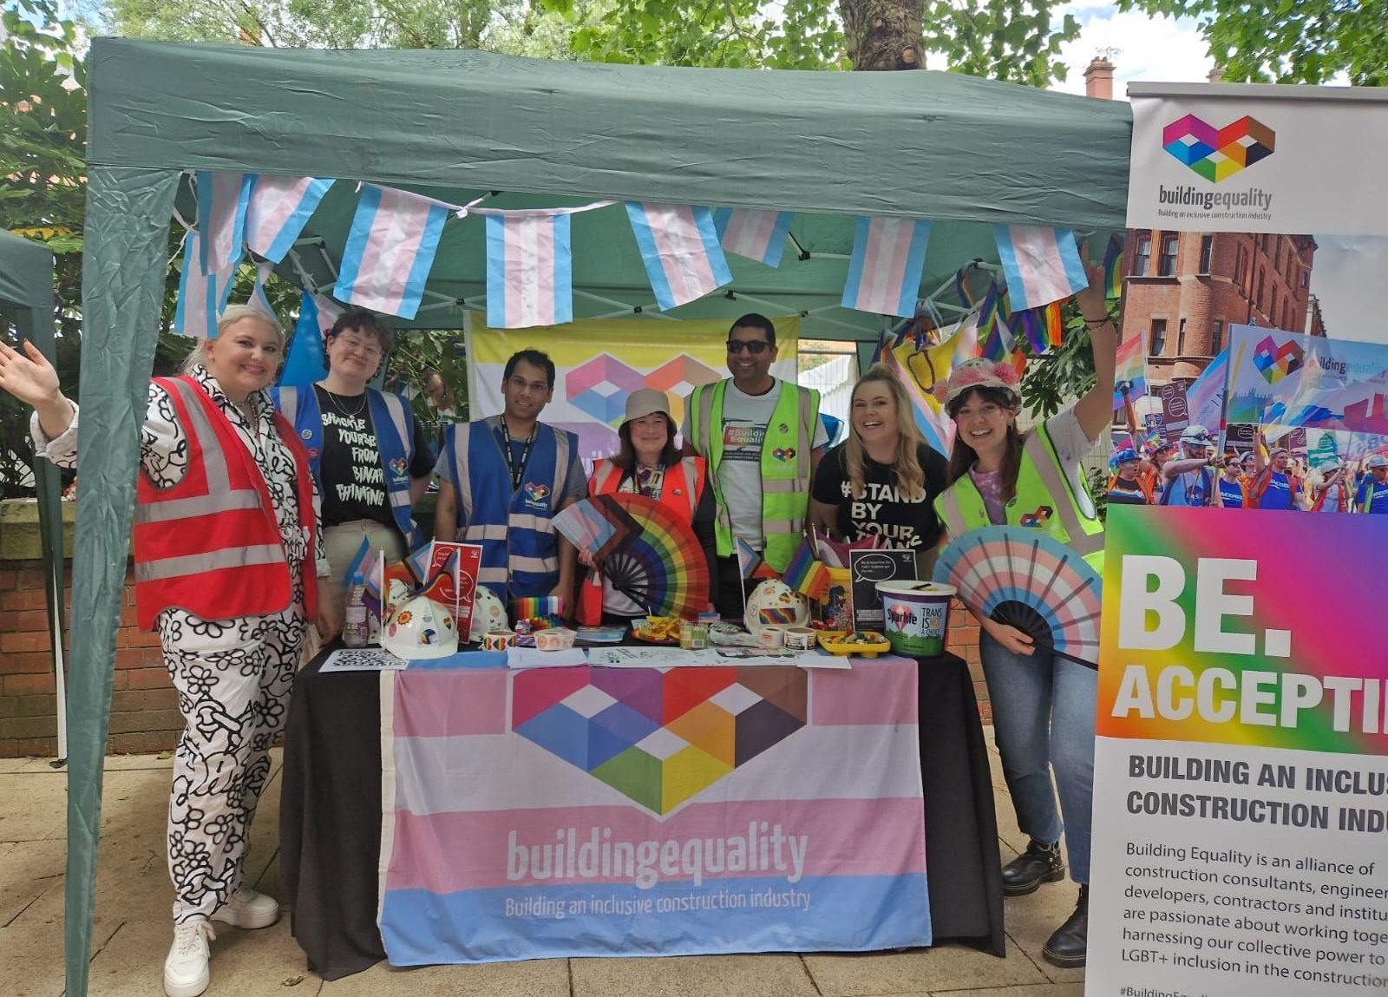
Misconceptions
This section addresses some misconceptions and points of misinformation that harm our community.
Notes:
Misconceptions
In the section, I’ll be going through some common misconceptions and points of misinformation. In highlighting these, I hope it’s clear how invalid and harmful these statements are.

Slide 64
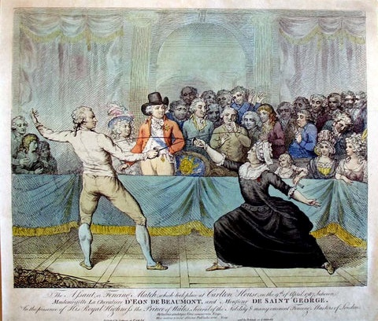
Trans people are new and didn't exist before
Trans people have always existed.
History often upholds narratives with limited inclusions of minorities.
This goes as far as negating events and experiences of minority groups.
Despite this, archives document the lives of iconic trans people through the centuries.
1
Misconception
Notes:
Misconception 1 : Trans people are new and didn't exist before
Trans people have always existed.
But History often upholds narratives with limited inclusions of minorities.
This goes as far as negating events and experiences of minority groups.
Despite this, archives document the lives of iconic trans people through the centuries.
In the next couple of slides, I’ll introduce some lesser-known trans people through history.

Slide 65
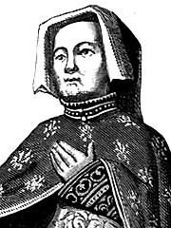
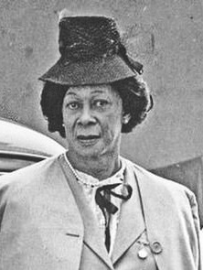
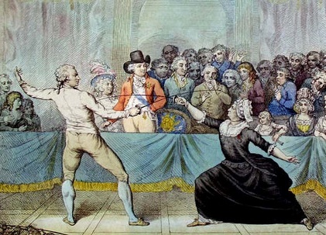
Trans people are new and didn't exist before
Eleanor Rykener
(late 1300s to early 1400s)
Worked as an embroiderer and a barmaid but little is known about her.
Lucy Hicks Anderson
(1886–1954)
American socialite, chef, and prohibition-era entrepreneur. She established a boarding house in Oxnard, where she became a popular hostess.
1
Chevalier d’Eon
(1728–1810)
After a career as a French spy, diplomat and soldier, she disguised her transgender identity, by coming out as transgender... In her later years she applied to be assigned female at birth, stating she was assigned male only to ensure she would inherit the family estate. The ruse paid off and she was accepted by the French and the British government - she was living in London at the time.
Misconception
Notes:
Starting in the 14th Century,
Eleanor Rykener (late 1300s to early 1400s) Worked as an embroiderer and as a barmaid but little is known about her.
Jumping through time to the 18th Century, the Chevalier d’Eon (1728–1810) has a remarkable story: After a career as a French spy, diplomat and soldier, she disguised her trans identity, by coming out as trans... In her later years she applied to be assigned female at birth, stating that she was assigned male only to ensure she would inherit the family estate. The ruse paid off and she was accepted by both the French and the British government as she was living in London at the time.
Lucy Hicks Anderson born at the end of the 19th Century, (1886–1954) was an American socialite, chef, and prohibition-era entrepreneur. She established a boarding house in Oxnard, where she became a popular hostess.

Slide 66
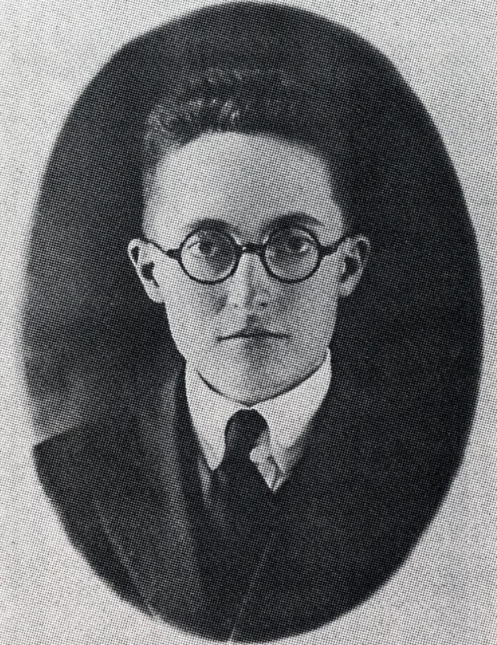
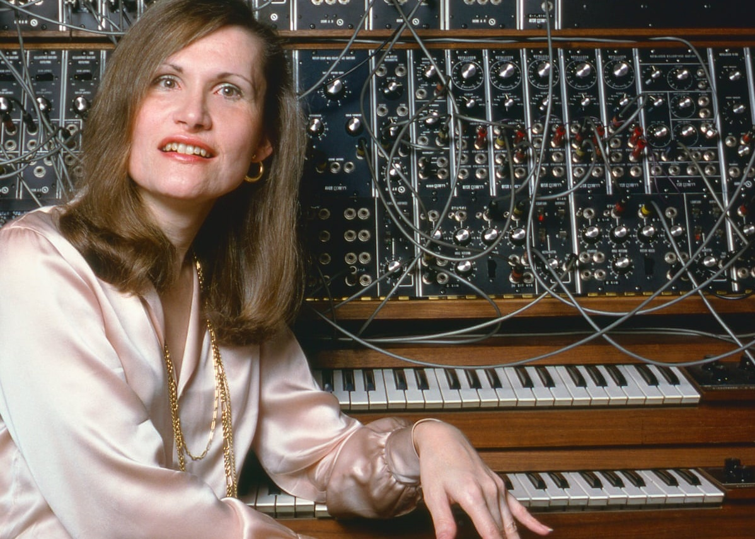
Trans people are new and didn't exist before
Alan L. Hart
(1890-1962)
pioneering radiologist, physician and tuberculosis researcher.
Willmer "Little Axe” Broadnax
(1916-1992)
talented gospel quartet singer known for his powerful tenor voice. He performed with his brother, who accepted and supported him, through his life.
1
Wendy Carlos
(born 1939)
pioneering electronic sound engineer and composer. Her music will be included among the major milestones of music of the 20th century.
Misconception
Notes:
Moving on to the 20th Century,
Alan L. Hart (1890-1962) was a pioneering radiologist, physician and tuberculosis researcher.
Willmer ‘Little Axe” Broadnax (1916-1992) was a talented gospel quartet singer known for his powerful tenor voice. He performed with his brother, who accepted and supported him, through his life.
Wendy Carlos (born 1939) is a pioneering electronic sound engineer and composer. Her music will be included among the major milestones of music of the 20th century.

Slide 67
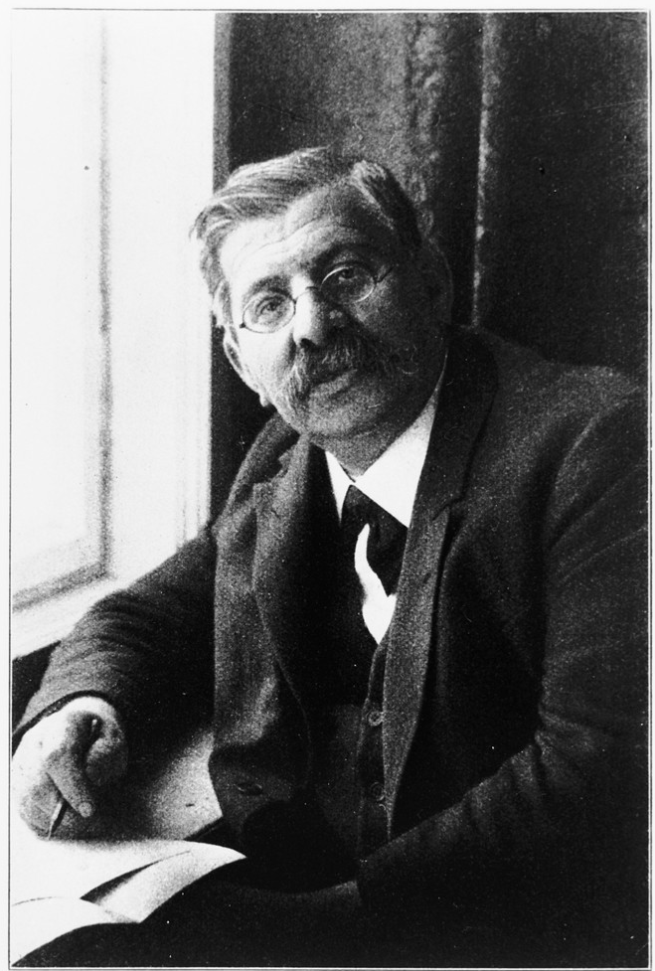
Trans people are new and didn't exist before
Magnus Hirschfeld
(1868–1935)
A famous doctor who helped pioneer the study of sexuality and gender.
Hirschfeld believed in the natural diversity of sexual and gender identities.
He challenged the traditional views of sexuality and fixed gender roles that were widespread at the time.
In 1933 he was forced to live in exile. In May 1933, Nazis looted Hirschfeld’s Institute for Sexual Science and destroyed much of the archives in the Berlin book burning.
1
In forcing Hirschfeld into exile and destroying his work, an important piece of trans history was purposefully destroyed by the nazi regime.
Misconception
Notes:
Another important person who spent his life supporting, and advancing research for LGBTQ people is:
Magnus Hirschfeld (1868–1935)
He was a famous doctor who helped pioneer the study of sexuality and gender in the late 1800s and early 1900s.
Hirschfeld’s belief in the natural diversity of sexual and gender identities was radically different from the traditional views of sexuality and fixed gender roles that were widespread at the time.
Having for years been targeted for being Jewish and gay, in 1933 he was forced to live in exile. In May that year, Nazis looted Hirschfeld’s Institute for Sexual Science and destroyed much of the archives in the Berlin book burning.
In forcing Hirschfeld into exile and destroying his work, an important piece of trans history and knowledge was purposefully destroyed by the nazi regime.

Slide 68
People will get angry if I make a simple mistake
Genuine mistakes are ok if they are not constant. Simply correct yourself and move on.
Make a mental note to prevent yourself from making repeated errors.
However, it is distressing to be repeatedly misgendered and this can be by multiple people in one day. This can understandably change how people react.
Making the effort to use the correct pronouns and name will be noticed and will help affirm the person's gender.
Going beyond pronouns and making the person feel welcome and included in certain spaces is even better (e.g., at a men's barber's, a women's networking event, creating an award ceremony category that includes non-binary people).
2
Misconception
Notes:
Misconception 2 People will get angry if I make a simple mistake
Genuine mistakes are ok if they are not constant. Simply correct yourself and move on.
At this point make a mental note to prevent yourself from making repeated errors.
However, it is distressing to be repeatedly misgendered and this can be by multiple people in one day. This can understandably change how people react.
Making the effort to use the correct pronouns and name will be noticed and will help affirm the person's gender.
Going beyond pronouns and making the person feel welcome and included in certain spaces is even better (e.g., at a men's barber's, a women's networking event, creating an award ceremony category that includes non-binary people).

Slide 69
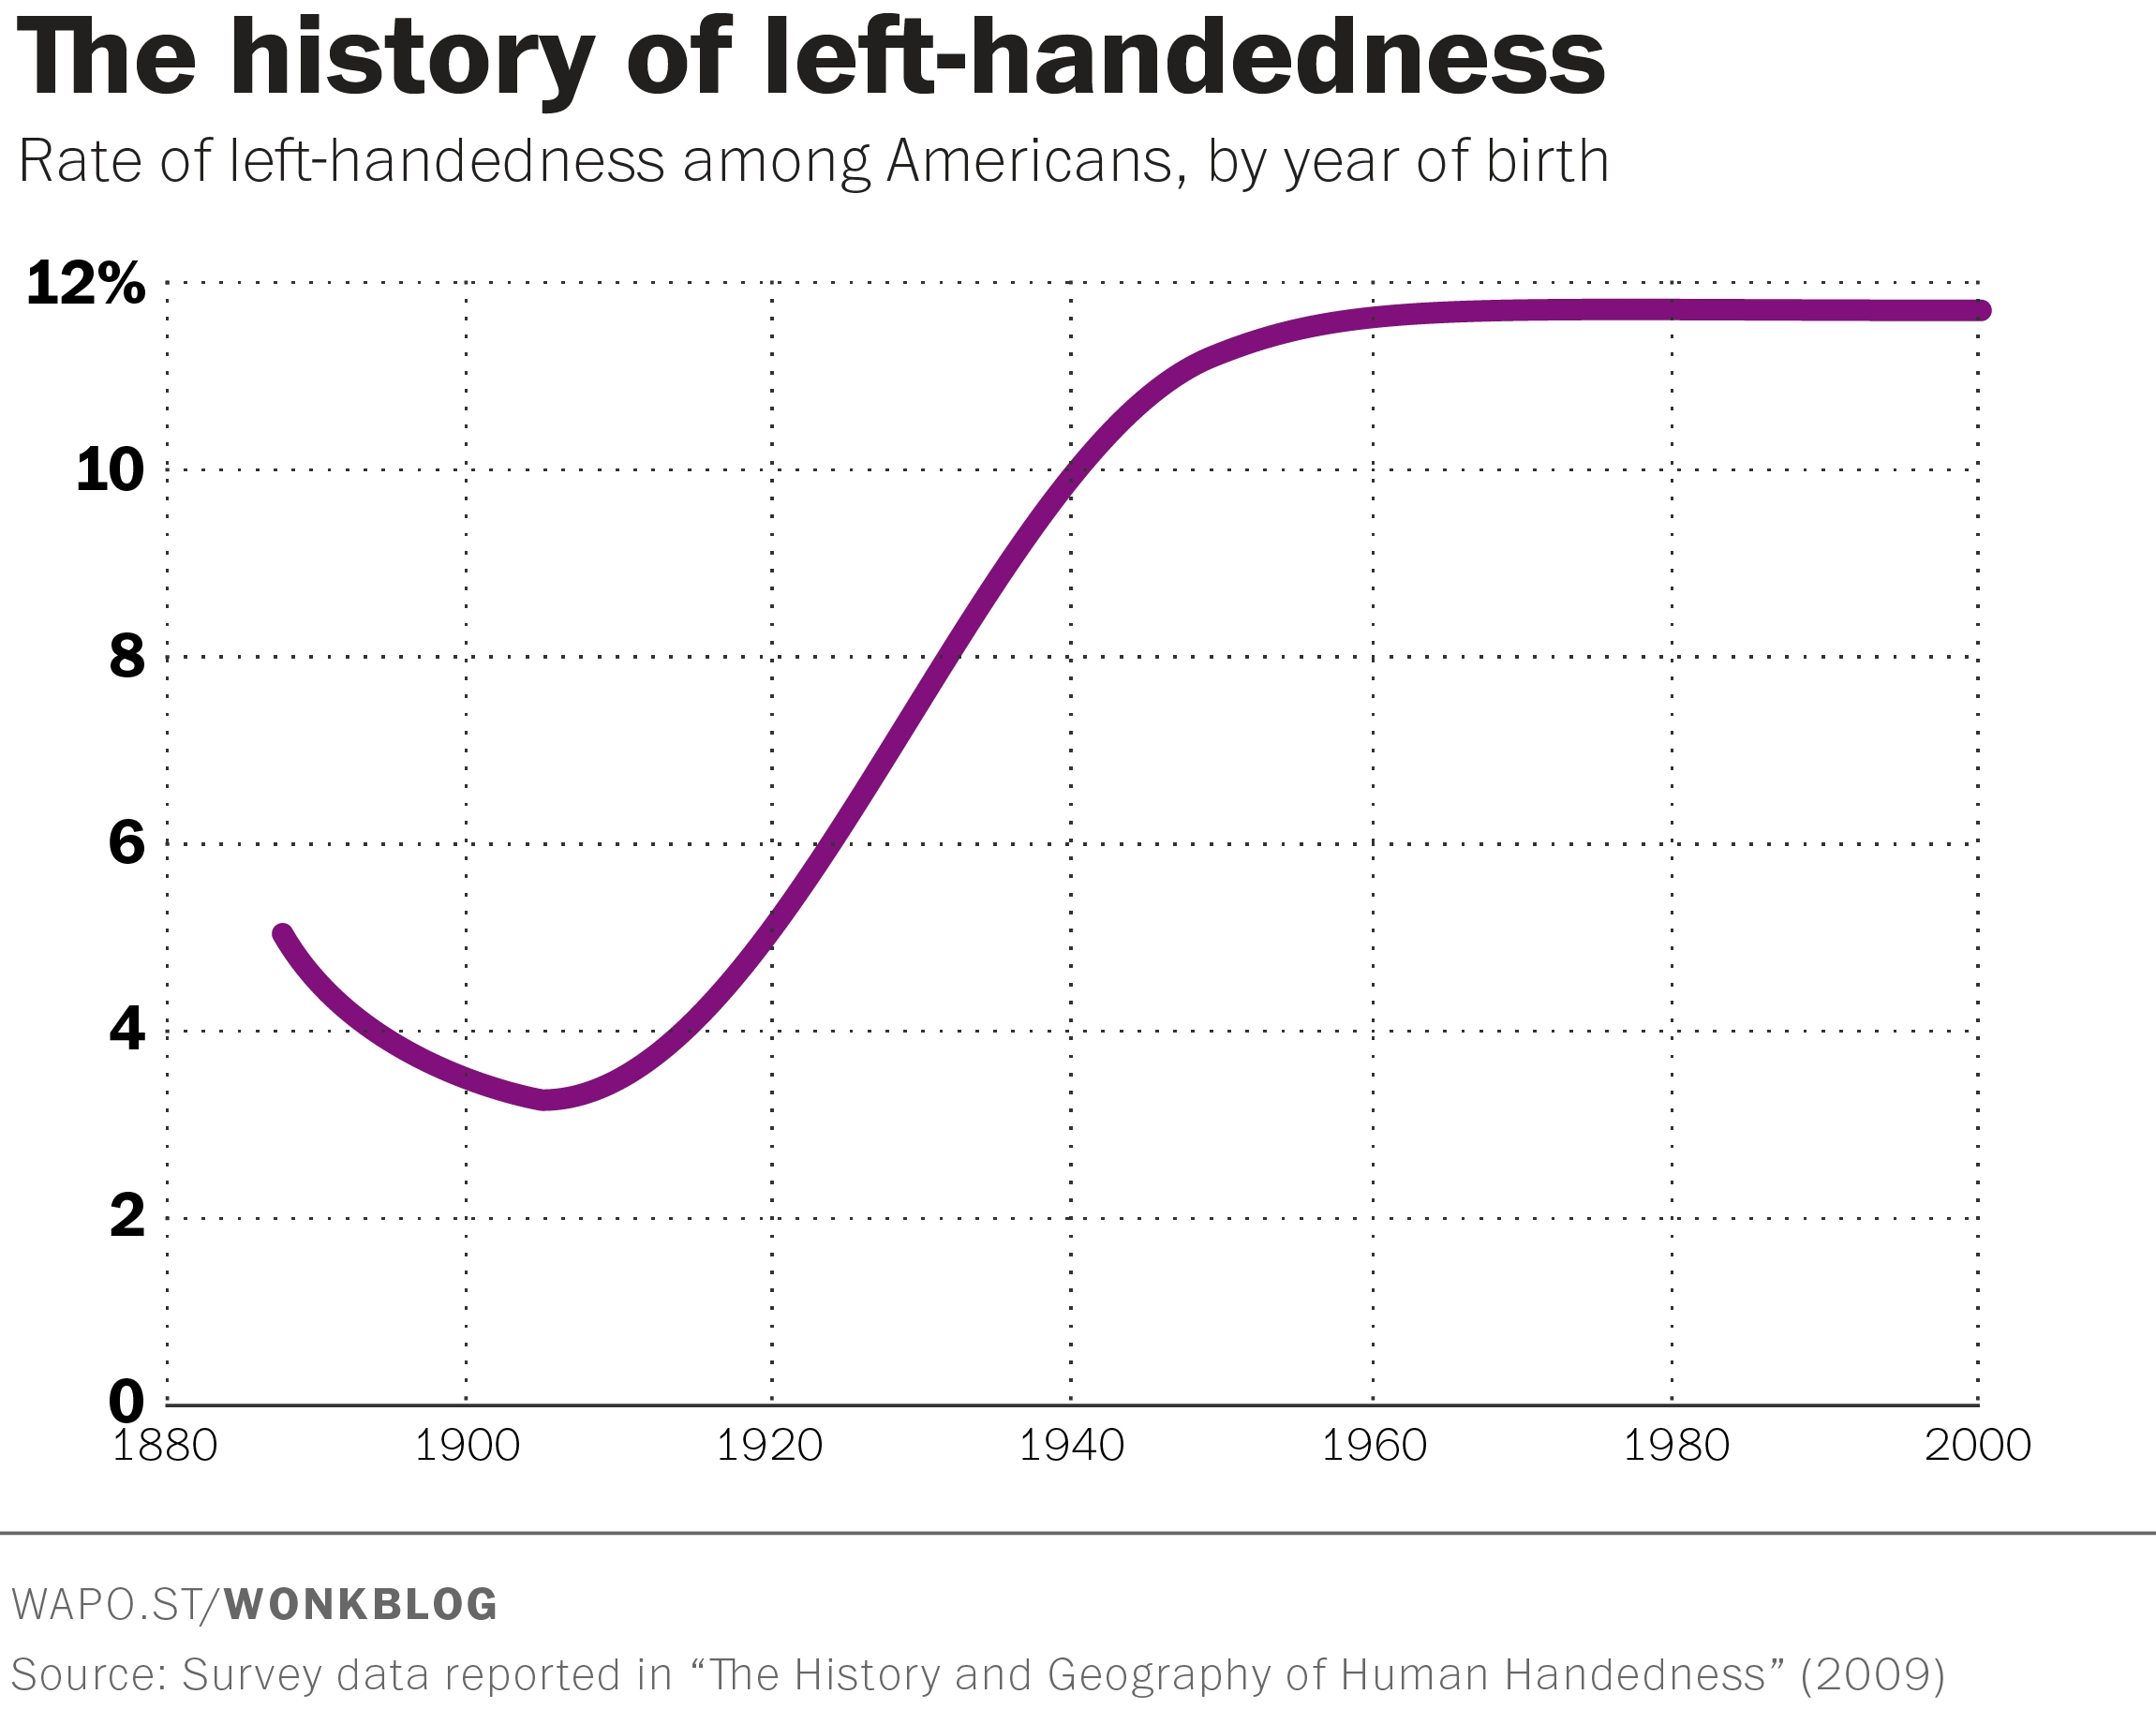
There is a trans epidemic
The apparent increase in numbers of trans youth is because there is more awareness, and more support for trans people to be themselves, and more visibility.
A similar example is with the history of left-handedness:
The graph shows significant increases in left handedness over the past 100 years – from under 4% in 1900 to almost 12% in 2000. This is because people are no longer punished for being left-handed.
3
Misconception
Notes:
Misconception 3 : There is a trans epidemic
The apparent increase in numbers of trans youth is because there is more awareness, and more support for trans people to be themselves. And there is more visibility.
A similar example is with the history of left-handedness:
The graph shows significant increases in left handedness over the past 100 years – from under 4% in 1900 to almost 12% in 2000. This is because people are no longer punished for being left-handed.

Slide 70
Transness reinforces gender stereotypes
Being trans is an experience unique to each person, just as cisgender people have different relationships with gender.
Gender exists within social rules, cultural norms, and a network of complex biological factors. But there is a societal expectation that everyone should conform to gender 'norms' or 'stereotypes'.
This feeds into a double standard of transmisogyny, where trans women are seen as always doing too much or too little. This narrative is hurtful and used to wrongly devalidate trans identities.
Presentation is an external expression, often read as gendered. Gender and presentation are not equivalents.
Presentation can be a means of self-expression and gender euphoria but also a way to encourage others to affirm their identity.
4
Misconception
Notes:
Misconception 4: The idea of transness reinforces gender stereotypes
Being trans is an experience unique to each person, just as cisgender people have different relationships with gender.
Gender exists within social rules, cultural norms, and a network of complex biological factors. But here is a societal expectation that everyone should conform to gender 'norms' or 'stereotypes'.
This feeds into a double standard of transmisogyny, where trans women are seen as always doing too much or too little. This narrative is hurtful and used to wrongly devalidate trans identities. This is particularly malicious in the context of poor accessibility to gender-affirming care.
Presentation is an external expression (hair, clothes, make up, body language...), often read as gendered. Gender and presentation are not equivalents.
Presentation can be a means of self-expression in line with gender or even completely regardless of gender. It can be a source of gender euphoria. But also a way to encourage others to affirm their identity, and therefore to make everyday life easier.

Slide 71
Being transgender is a mental illness
World Health Organisation stopped classifying trans and gender diverse identities as a mental disorder in 2019.
Films and news headlines have been portraying trans people in a negative light, as mentally ill, and as threats to society for decades. The same has been true for other LGBTQ+ identities.
This is why authentic representation is so important, not just for the community but in wider society.
There are lots of great things about being trans, cue next slide.... !
5
Misconception
Notes:
Misconception 5: Being transgender is a mental illness
The World Health Organisation stopped classifying trans and gender diverse identities as a mental disorder in their latest International Classification of Diseases (known as ICD-11) published in 2019.
Films and news headlines have been portraying trans people in a negative light, as mentally ill, and as threats to society for decades. This is in part due to the legacy of stigmatising medical guidance which has impacted how trans people are portrayed in culture. The same has been true for other LGBTQ+ identities.
For example, we have seen transness used for 'shock' factor in past films and scaremongering in recent media pieces. These are lazy depictions by people who know little about trans people themselves.
This is why authentic representation is so important, not just for the community but in wider society.
There are lots of great things about being trans, cue next slide.... !

Slide 72
TRANS JOY

Slide 73
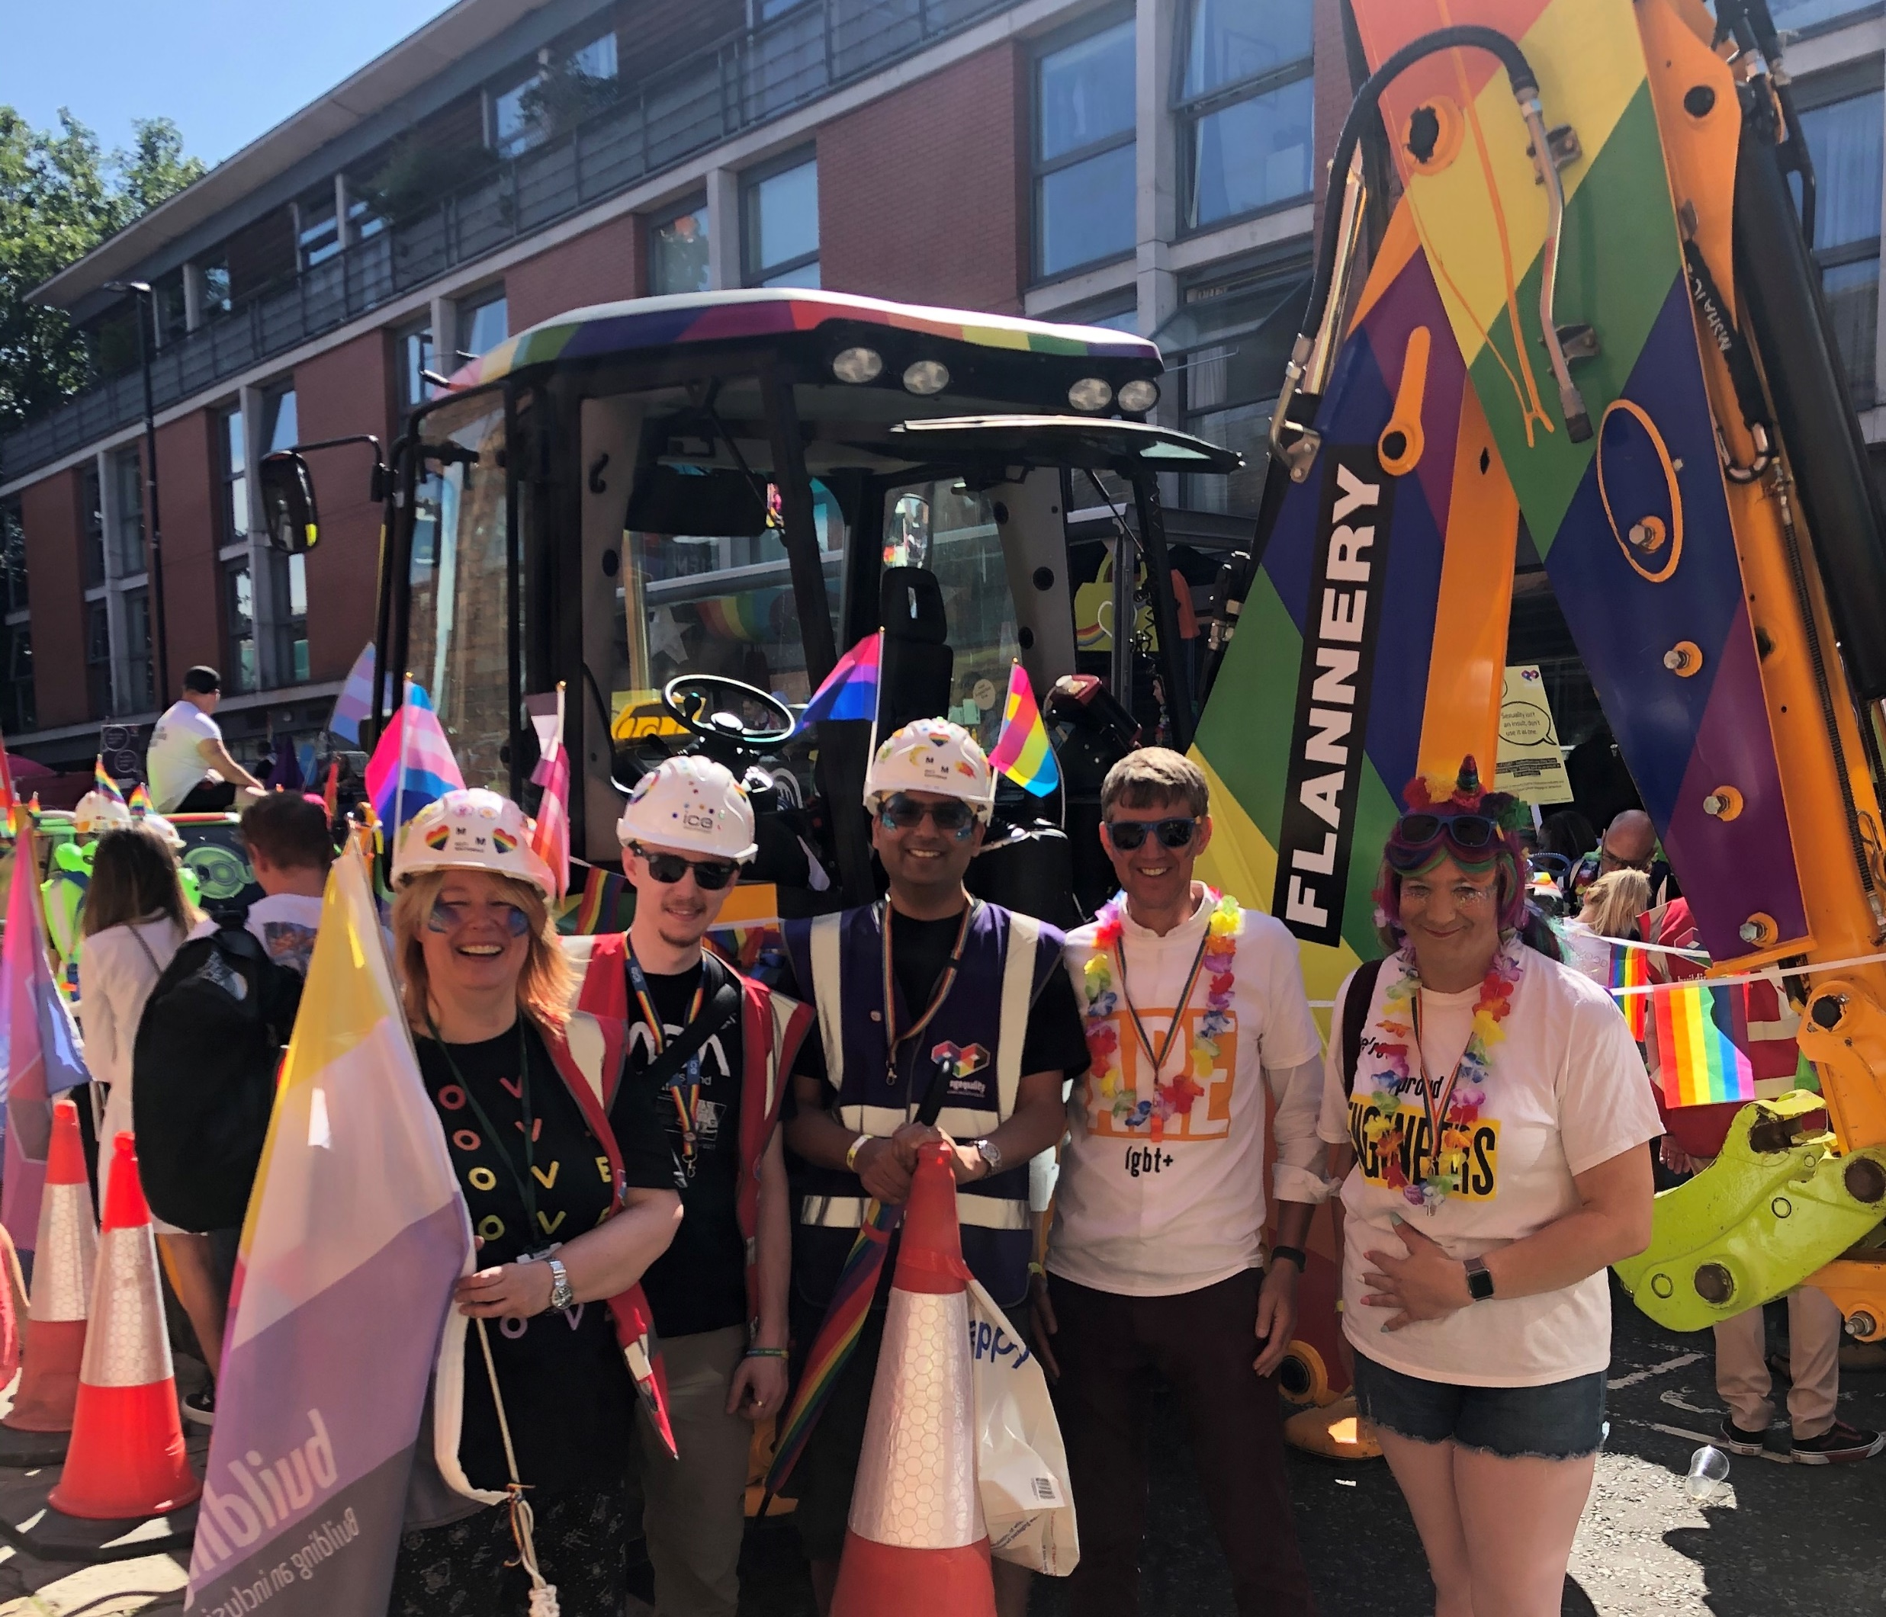
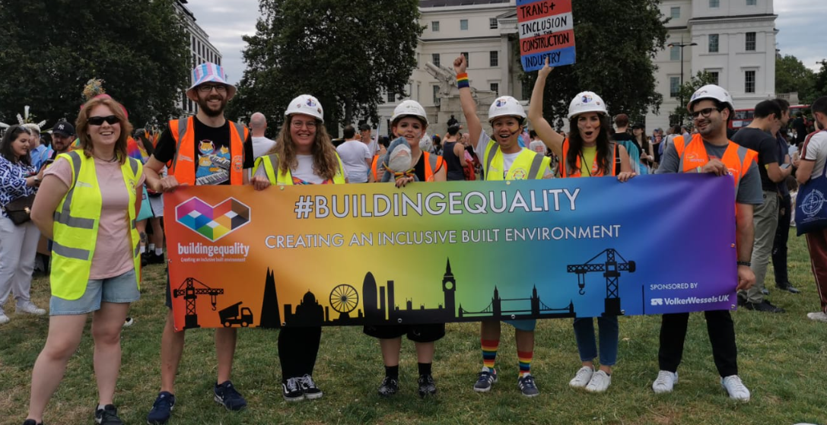
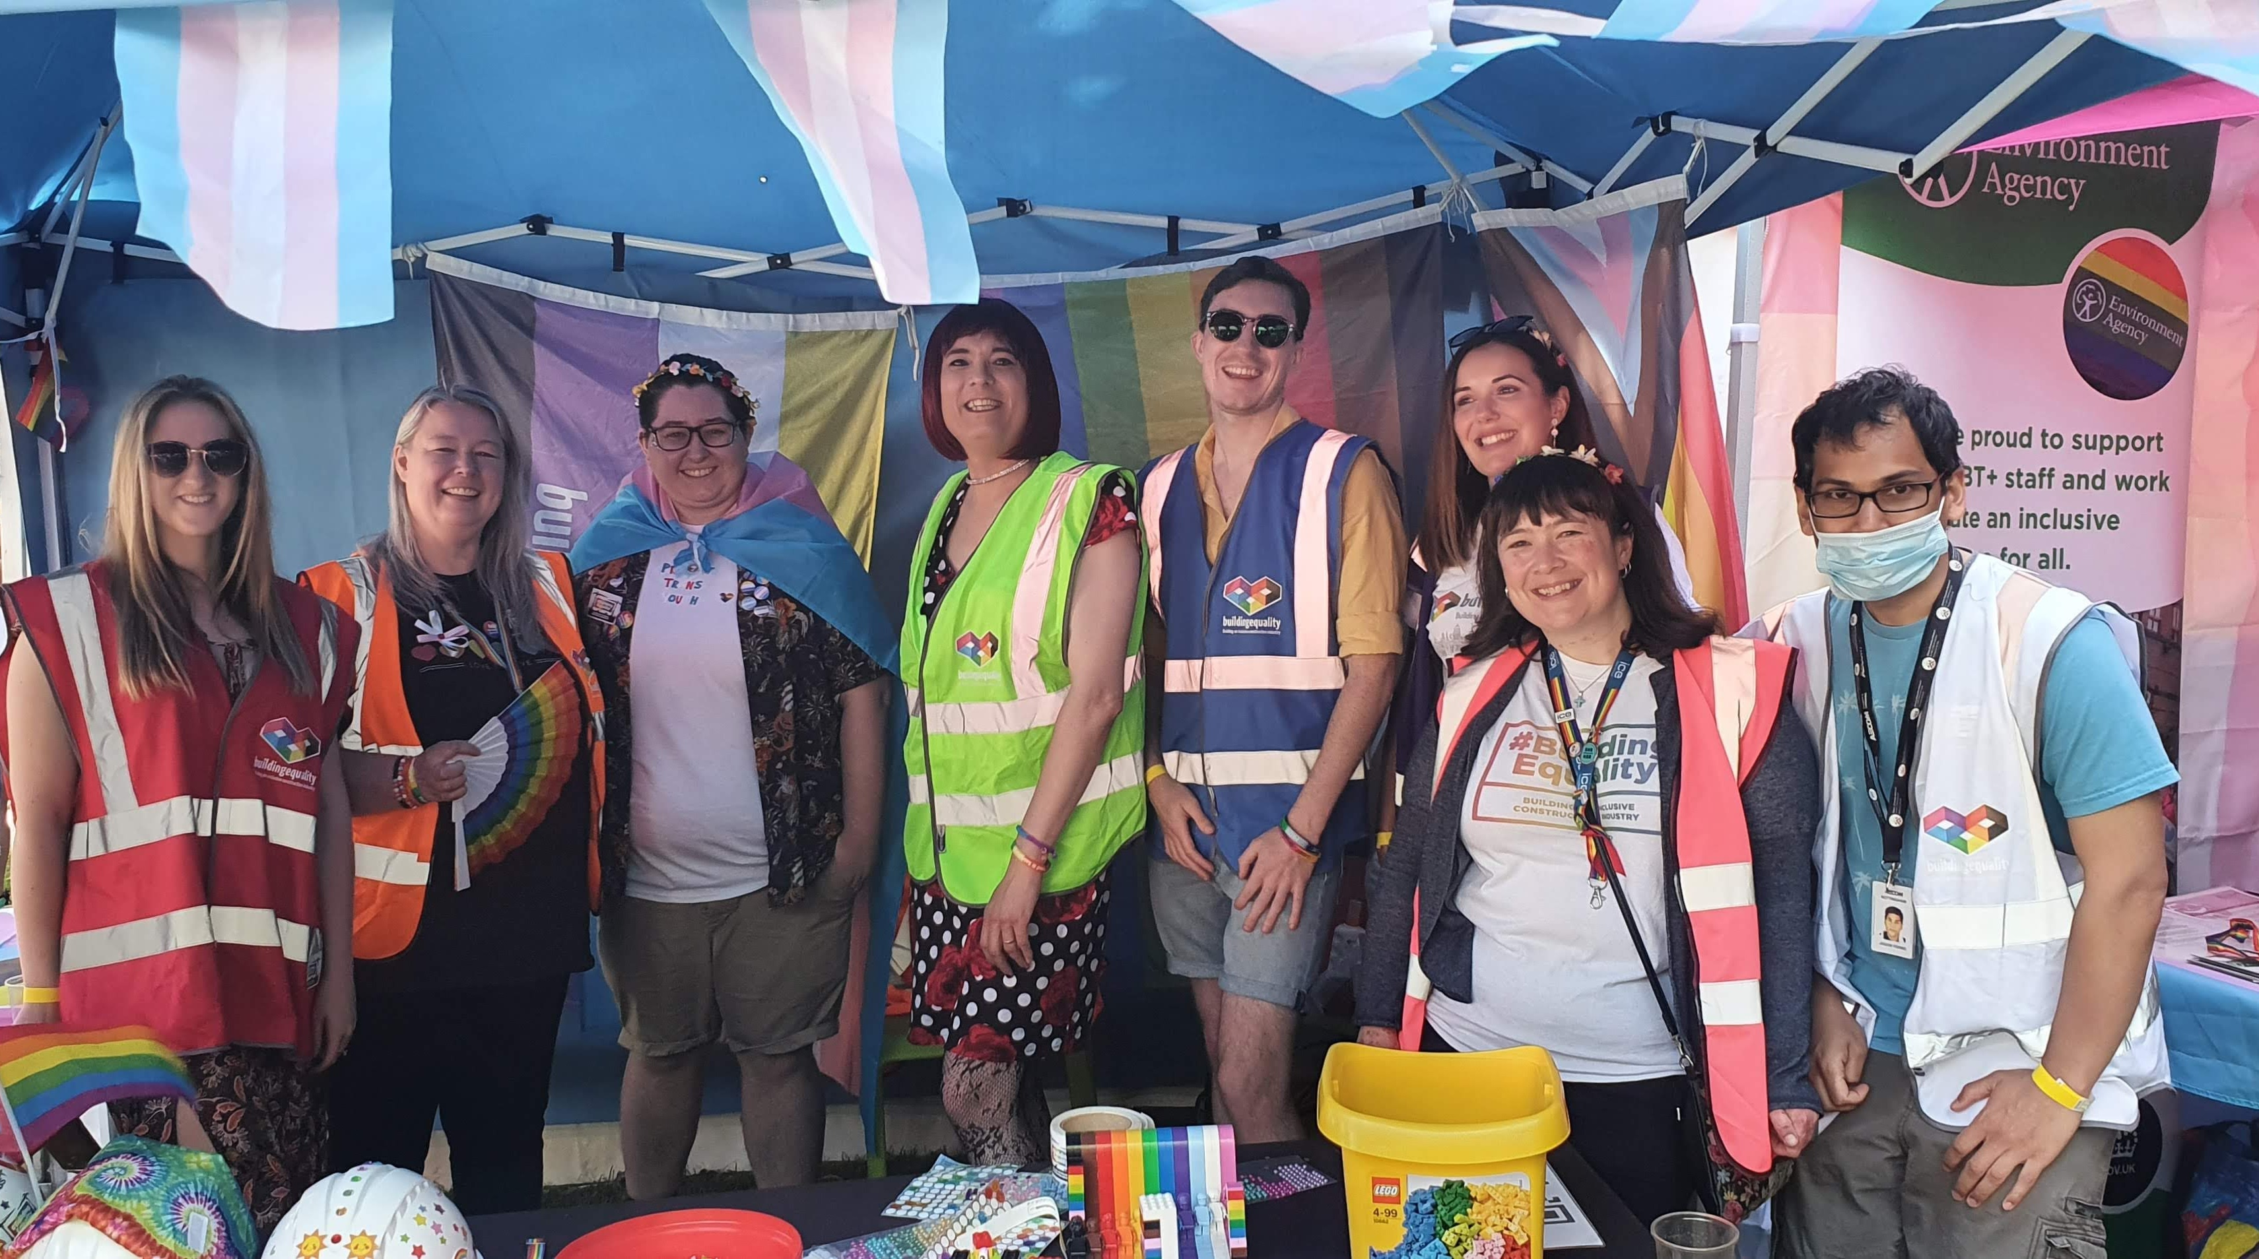

Slide 74
Notes:
A photo from Their Time to Sparkle (hosted by Building Equality Greater Manchester) in 2022. This video was one of three following a trans man transition and journey. Their Time to Sparkle | Building Equality (buildingequalityuk.com)

Slide 75
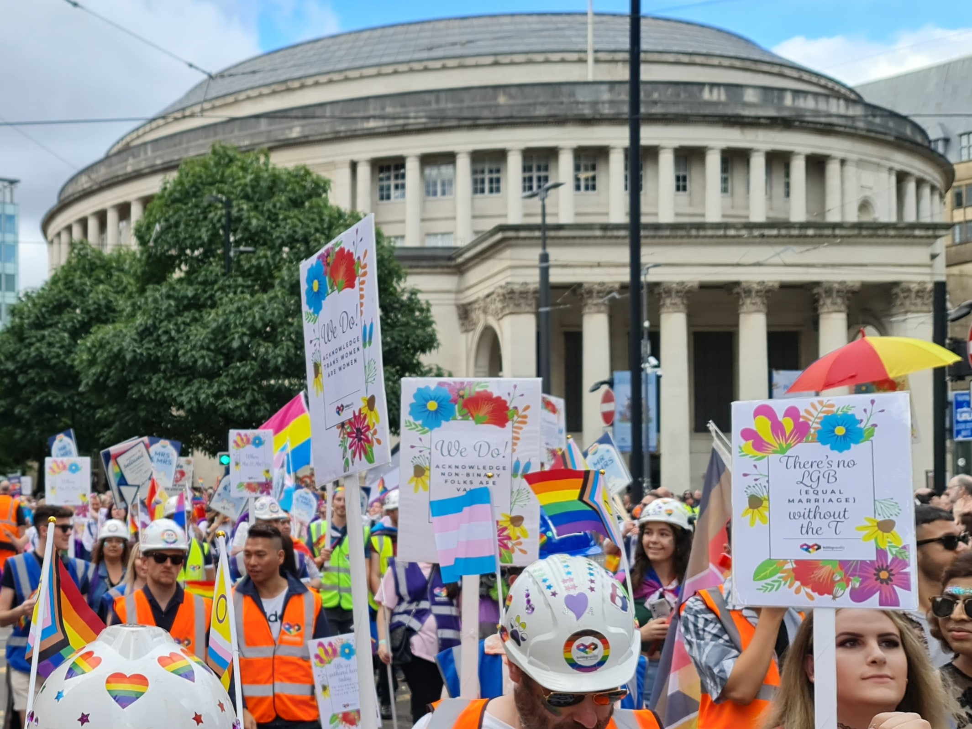
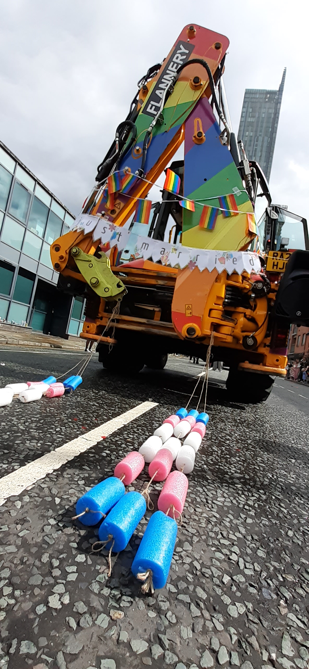
Notes:
Manchester Pride 2023, celebrating 10 years of Equal Marriage. Raising awareness of some of the issues still facing the trans and non-binary community in getting married as their true authentic selves.

Slide 76
Key takeaways + next steps
Thank you for joining us to learn more about trans allyship! To be an advocate we need you to use your voice, so please share this resource pack with others!
There are several more stories and educational pieces included in the full pack
You can split this into deck into individual sections, and use it as EDI moments if preferred
Do keep a critical eye on what you see in the news and in your feed
Keep supporting your LGBTQIA+ colleagues, ask and actively listen
LGB with the T!

Slide 77
Resources
Building Equality website https://www.buildingequalityuk.com/
Buildingequalitylgbt@gmail.com
LGBTQIA+ Wiki: https://lgbtqia.mywikis.wiki/wiki/Main_Page
Nonbinary Wiki: https://nonbinary.wiki/wiki/Main_Page
Gendered Intelligence: https://genderedintelligence.co.uk/index.html
Mermaids: https://mermaidsuk.org.uk/
Global Butterflies: https://globalbutterflies.com/
Stonewall: https://www.stonewall.org.uk/our-work/campaigns/come-out-trans-equality\
Stonewall: https://www.stonewall.org.uk/the-truth-about-trans
A European view on trans issues: https://tgeu.org/
Inclusive Environment training https://inclusive.designcouncil.org.uk/

Slide 78
Q&A
This toolbox talk has been co-developed by Building Equality Members: AECOM, Mott MacDonald, Dyer & Butler, WSP, and BDP

